Slide 1
Module 2
Food Trends in the Era of Climate Change

Slide 2
WELCOME TO SUSTAIN MODULE 2
01
Food and the Environment
In this module, you will learn about Climate Change & how as Food Service providers we can have an impact by the actions we choose to take.
On completion, you will have upskilled in 3 key topics that are very much on trend in the food service sector.
02
Reducing Food Waste
03
Sustainable Packaging

Slide 3
MODULE 2
1. Food Service and the Environment

Slide 4
Introduction:
Climate change is considered one of the most serious problems faced by humanity today. The food service sector, which encompasses hospitality and institutional catering, contributes in different ways to greenhouse gas (GHG) emissions.
Many in the sector are working to reduce its effects on climate change through increased energy efficiency, recycling and re-use practices, and reduced food waste.

Slide 5
Climate Change Factors
When people think “climate change and food,” many go first to the impact of farming on climate change – meat production and methane, soil erosion etc
According to the Food and Agriculture Organization of the United Nations’ Seminal 2016 report, Livestock’s Long Shadow, the livestock sector alone is responsible for 18% of the world’s total greenhouse gas emissions
Yet it has recently been estimated that the entire food system contributes from 21-37% of the total GHG emissions (2021 IPCC Physical Science Report).

Slide 6
The Food Chain & Greenhouse Gas Emissions
Emissions of Human-grade GHGs occur at every step along the modern Food-chain – From seed to plate to landfill…
PRODUCTION
PROCESSING
DISTRIBUTION
CONSUMPTION
WASTE
Greenhouse gas emissions are greenhouse gases vented to the Earth's atmosphere because of humans. Reducing emissions from food production will be one of our greatest challenges in the coming decades.
READ Food production is responsible for one-quarter of the world’s greenhouse gas emissions - Our World in Data

Slide 7
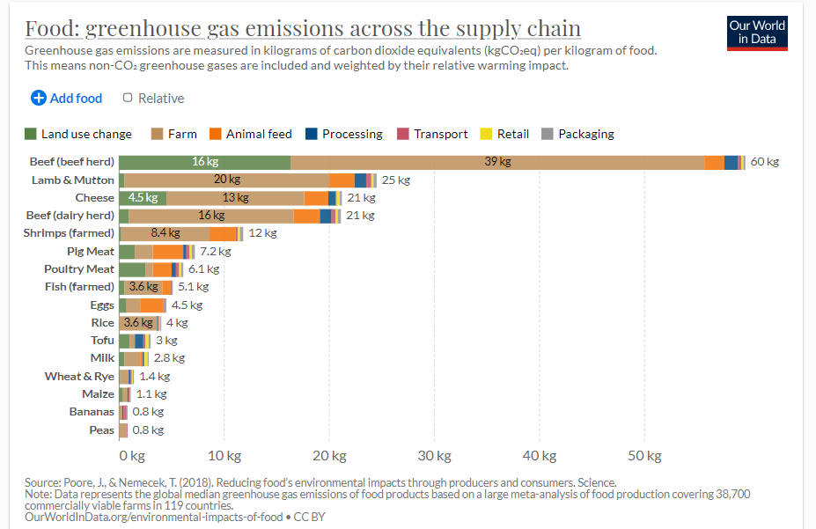
The Food Chain & Greenhouse Gas Emissions
Our World in Data collates the work of thousands of researchers around the world to allow knowledge on the big problems accessible and understandable.
Search their presentation of the impact of food across the supply chain on GHGs, it makes for fascinating reading.

Slide 8
Living well within ecological limits will require fundamental transitions in the societal systems of production and consumption that are the root cause of environmental and climate pressures, including the food system and that such transitions will entail profound changes in dominant institutions, practices, technologies, policies, lifestyles and thinking.
Dr. Cathy Maguire
READ
https://ec.europa.eu/info/sites/default/files/conferences/food2030_2017/4.1.2_food_in_a_green_light-cathy_maguire_eea_0.pdf

Slide 9
Climate Change Factors
A recent study in Biosciences suggests that food production will likely need to increase between 25% and 70% to meet 2050 food demand.
Feeding 10 Billion people sustainably by 2050 requires closing three gaps:
Food gap
Land-gap
GHG mitigation gap

Slide 10
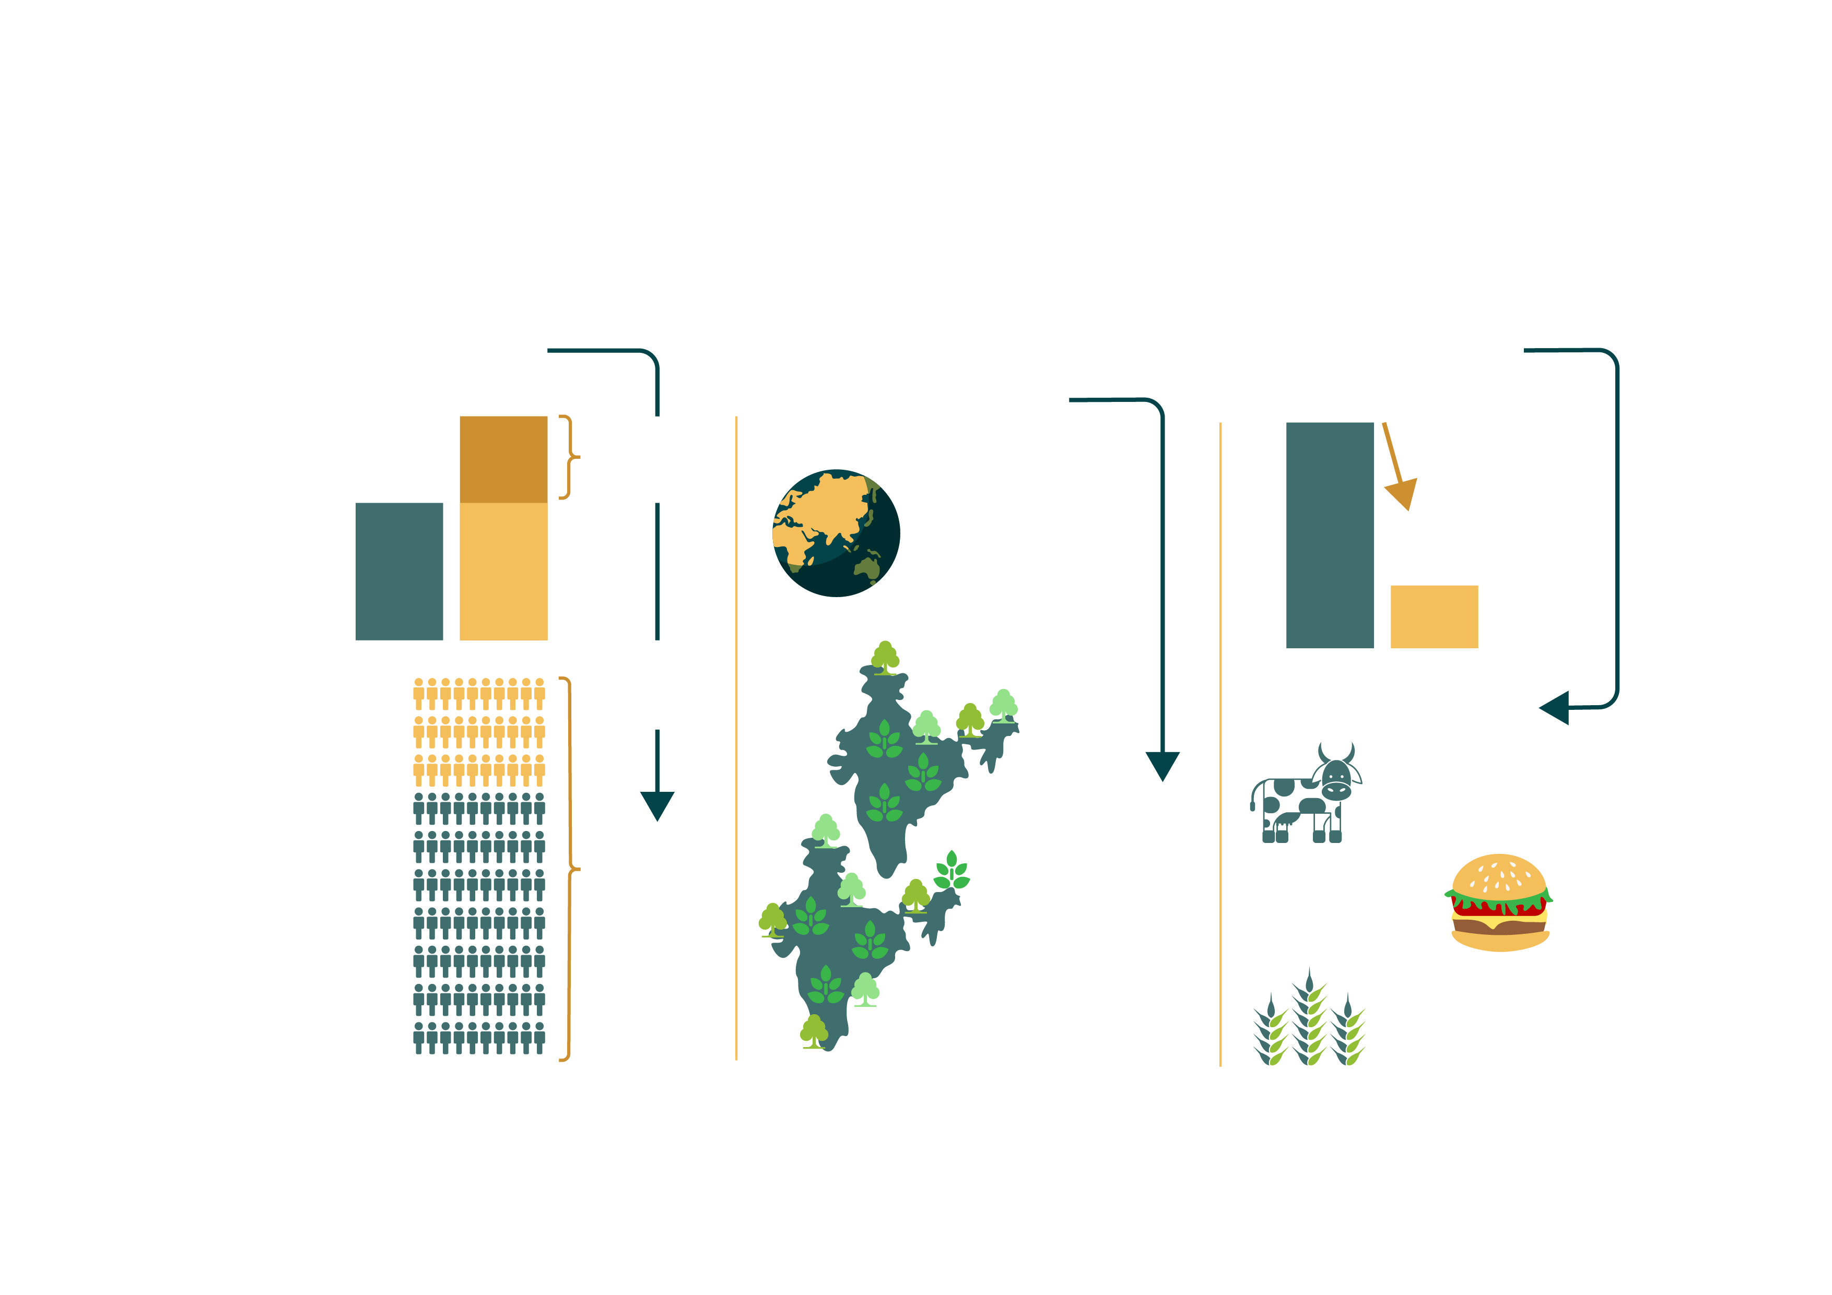
What needs to happen…
WE WILL NEED
WE NEED TO PREVENT AGRICULTURE FROM EXPANDING
WE CAN LOWER EMISSIONS
56%
2010
2050
we currently use
12 Gt CO₂e
more food
~50%
of the world’s vegetated land for agriculture
-67%
2010
2050
4 Gt CO₂e
TO FEED
NEARLY
WITH INNOVATIVE
TECHNOLOGY LIKE
TO SAVE AN AREA OF FORESTS NEARLY
10B
Improved feeds
2X
the size
of India
people in
Plant-based
burgers
2050
Resilient crop breeds
Source: http:www.wri.org/sustfoodfuture

Slide 11
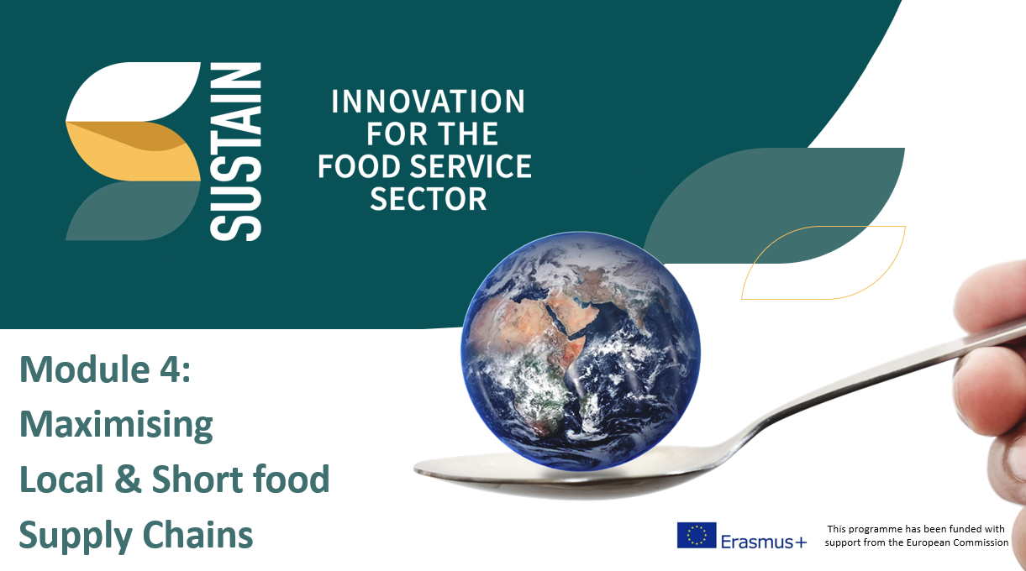
A great place to start .. the UN SUSTAINABLE DEVELOPMENT GOALS
The UN Sustainable Development Goals (SDGs) are the blueprint to achieve a better and more sustainable future for all. They address the global challenges we face, including those related to poverty, inequality, climate change, environmental degradation, peace and justice.
The 17 Goals are all interconnected to ensure that no one is left behind.
Businesses are use the Goals as a map to ‘do good’
and benchmark against when developing any new
product or service.
SDGs are discussed also in Module 4.

Slide 12
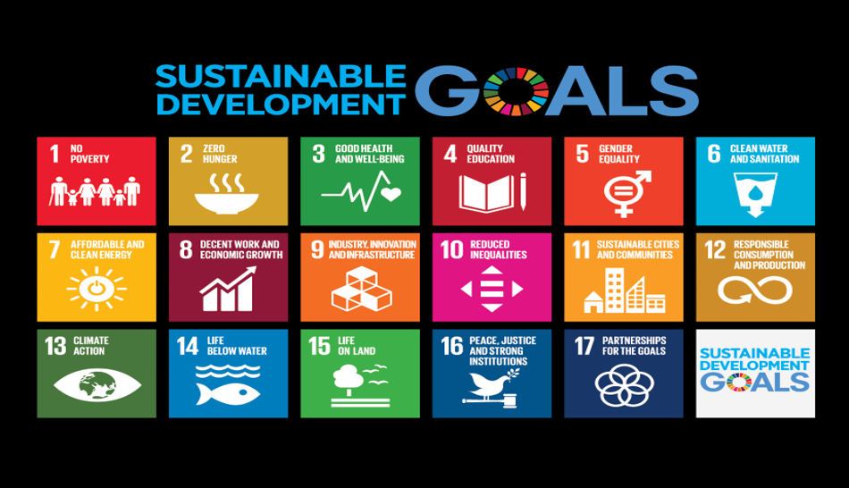

Slide 13
The EU DEVELOPMENT GOALS…
AS RELATES TO FOOD SERVICE INDUSTRY
Champion innovative actions that transition to zero waste solutions. Some areas of food service are regarded as highly wasteful sectors (e.g. event catering & food delivery services). How can you introduce sustainability measures to reduce impact in these areas?
It can make strong business sense to engage in Initiatives to establish zero waste or package-free food service. Enable separate collection of different waste streams, including plastic packaging and organic waste.
Funding opportunities check out local & regional funding for investments such as infrastructure that facilitates the return of reusable packaging (reverse logistics) recognising their benefits in reducing waste & supporting local economic development.
Invest in integrating food supply chains between rural & urban areas, including food services, waste management & soft mobility, recognising the opportunities that exist for reducing waste and emissions.

Slide 14
Sustainable Diets
Sustainable Diets are those that:
Protect biodiversity and ecosystems
Are culturally acceptable
Are easy to come by and affordable
Deliver nutritious, heathy, safe and adequate food
Optimise natural and human resources
http://assets.wwf.org.uk/downloads/wwf_catering_full_report.pdf?_ga=2.260765005.179122158.1561971478-1152898316.1561547209

Slide 15
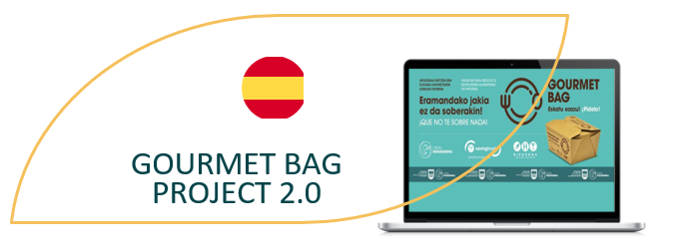
CASE STUDY – BE INSPIRED
This Spanish concept was derived to provide the population with a tool to fight against food waste. Eco-friendly receptacles called “Gourmet Bags” are made available to diners in restaurants so they can take away the food they are unable to eat. The idea is to make consumers aware of food wastage and that unwanted portions of food are not just rubbish to be disposed of, while simultaneously using an environmentally friendly approach to do this.
The “Gourmet Bags” are made from recycled paper and may be placed in microwave ovens. They are totally compostable and when they are no longer required, they may be deposited in the organic waste recycling container thus closing the economic circle.
VISIT “Gourmet Bag” 2.0: jatetxeetako elikagaien xahutzea saihesteko soluzio ekologikoa - Artikulua - Gipuzkoa ETORKIZUNA ORAIN
READ THE FULL STORY 43-Gourmet-Bag-Project.pdf (foodinnovation.how)

Slide 16
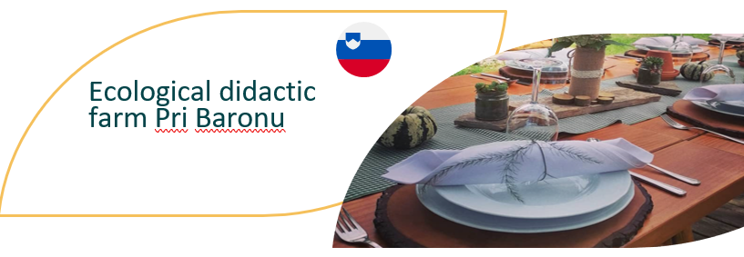
CASE STUDY – BE INSPIRED
This farm in Slovenia is a great example of sustainability. Through the promotion of organic farming and traditional self-sufficiency skills, Pri Baronu teach children of the community that, Healthy Organic food contains more nutrients, flavours and aromas than conventionally grown parallels and show them how food doesn’t have to be loaded with pesticides or chemical fertilizers. They demonstrate how Organic food production is more than the cultivation of vegetables and fruits, but also animal husbandry, aquaculture, herbalism, and viticulture.
This Organic farm follows sustainable production, processing, and distribution of food. Special attention is paid to the integration of natural methods and the circulation or reuse of natural matter. Their approach provides transparency over all operations that affect the "farm to fork" concept. By following natural cycles, there is an emphasis on seasonal availability and the promotion of such is crucial.
VISIT Contact and company details - Pri Baronu
READ THE FULL STORY 46-Ecological-Didactic-Farm-1.pdf (foodinnovation.how)

Slide 17
Carbon Footprint of Food
As food service businesses, it is important to consider carbon when caring for our planet.
We often hear of the carbon footprint of activities, but did you know that carbon is treated like a currency for greenhouse gases.
Just like we talk about calories in nutrition, carbon is used to create an overview of the combined damage caused by the greenhouse gases produced through a process or activity.

Slide 18
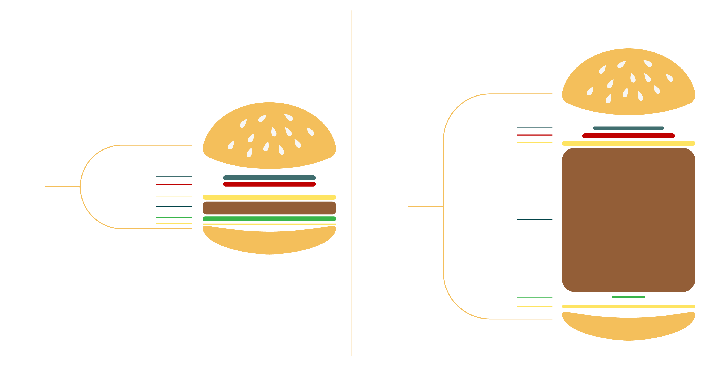
PERCENTAGE WEIGHT OF INGREDIENTS IN A CHEESEBURGER
THE CARBON IMPACT OF DIFFERENT INGREDIENTS IN A CHEESEBURGER
Onion 1.0%
Tomato 2.0%
Cheese 3.0%
Bread 7.35 %
(per half bun)
Onion 14.3%
Tomato 13.7%
Bread 0.5 %
(per half bun)
Cheese 9.6%
Beef 37.5%
Lettuce 5.5%
Beef 91.5%
Butter 4.8%
Lettuce 0.2%
Butter 1.2%
Source

Slide 19
evocco App
“Track. Improve. Offset.”
“Take control of your food shopping’s carbon footprint with the Evocco mobile app.”
This company in Ireland built an App to help people take the first steps towards a greener future by tracking the carbon footprint of their food shopping, and they believe that there’s no tastier place to start than with the food you eat!
Simply photograph your food shopping receipt & get its carbon footprint score, then get personalized tips on how to improve your score. Finally for a few extra cents contribute to the planting of native woodland to make what you buy and eat carbon neutral
https://www.evocco.com/about

Slide 20
Climate-Friendly Products
Shifting meat-centric menus and product offerings toward less resource-intensive foods like vegetables, fruit and legumes will help meet global climate goals.
Introducing more plant-based foods is an important way to reduce pressure on the climate. But changing people’s behavior requires more than information. It also requires more available options that consumers will want to pick. This is where you as a food service provider can seize an opportunity.

Slide 21
Carbon Counted Menus
Your carbon footprint is the amount of energy, greenhouse gases, and waste that is generated by your food service business on any given day. By introducing a carbon counted menu, you give the power to the consumer to make informed environmental choices about what they eat.
Try this free Food carbon footprint calculator - My Emissions.

Slide 22
Chef Ravinder Bhogal’s restaurant celebrates ‘immigrant cuisine’ in the heart of London. Since 2019, Bhogal and her husband, Nadeem, have been working to achieve carbon neutrality across their business and, having done so in 2021, will become the first UK independent restaurant to receive an accreditation. Key actions have included:-
Changed energy supplier,
Brought on board expertise, by signing up to Climate Neutral, a US-based non-profit organisation that works out your carbon footprint based on as much data as you can provide, advises on ways to reduce it and offsets the emissions that we can’t eliminate
Switched to a green, zero-to-landfill waste management company,
Partnered with a biodynamic farm
READ Why carbon neutral restaurants are the future of dining out (telegraph.co.uk)

Slide 23
MEAT AND FACTORY FARMS…THE IMPACT
70% of all agricultural land in the world is tied up with livestock in one form or another: meat, milk, eggs
Much meat production occurs on factory farms- what are known as CAFO’s: Concentrated Animal Feeding Operations: facilities that confine animals for at least forty-five days a year and do not raise their own feed.
Globally, one third of the world’s cereal harvest, including half of all corn and 90% of all soy, is now diverted to feed animals on factory farms:
http://www.fao.org/worldfoodsituation/csdb/en/
In the EU the figure hovers around 14-16%
https://ec.europa.eu/eurostat/statistics-explained/index.php/Agricultural_production_-_crops
In Module 4, we look at the importance of short supply chains.

Slide 24
PLANT BASED MEAT SUBSTITUTES
Over the past few years, food innovators have focused on replicating the taste and texture of beef, chicken and other animal-based products (most recently seafood) .
The intent is to curb the environmental impact of emissions, water and land use, among other environmental concerns.
In Module 6, we explore how some of these technologies are being developed to curb the associated impact of meat and other damaging products.

Slide 25
Packaging Waste
Food production and waste is not the only source of environmental damage in the Food Service Industry.
Plastic production drives the fossil fuel industry as well as polluting our seas and contaminating our natural resources.
As food service businesses, it is important to look for opportunities to design out all harmful waste

Slide 26
MODULE 2
2. Reducing Food Waste

Slide 27
Food Waste
Food waste is an issue that affects all aspects of society, producers, growers, retail, hospitality, consumers and those who experience food poverty, with roughly one third of all food produced going to waste.
While food waste is a global issue, the streams differ in developing and developed countries. In developing countries, the majority of losses occur in processing and post-harvest, whereas in developed countries, the majority of the losses occur at the retail and consumer level.

Slide 28
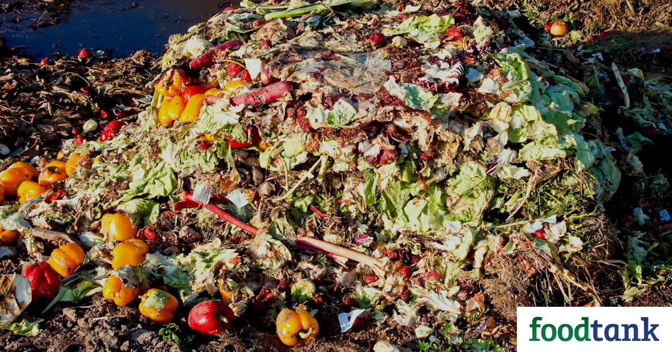
Food Waste in Business
Food waste can be a significant cost to businesses. When it comes to food waste, most businesses just think about the disposal costs. Disposal costs represent only a small fraction of the “true” cost of food waste. It has been estimated that each tonne of food waste can cost approximately €2,000 – €5,000.
The solution to this waste of money for any business is to prevent food waste.
To do this, a business must first identify where and why food is being wasted, and then use this information create specific solutions to prevent food waste being generated in the first place.

Slide 29
Food Waste in Business
There are large amounts of edible food that do not even reach consumers but still end up in the bin, often referred to as surplus food (from production, distribution & retail).
The reasons for this include short-dated stock, over-production, distribution delays, end-of-line production, mis-shapen fruit and vegetables, unsold food from the service industry, etc.

Slide 30
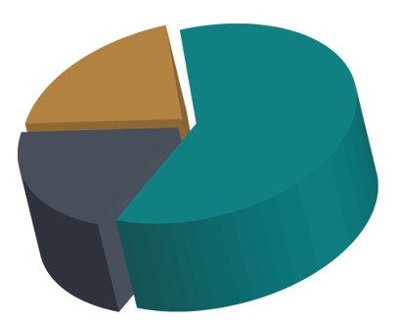
The 3 Main Categories of Food Waste
20% unavoidable food waste
60%
avoidable food waste
20%
potentially avoidable food waste

Slide 31
Description of the 3 categories:
60% Avoidable: plate scrapings, leftovers , gone off fruit and veg, passed date items, damaged stock which cannot be used due to Health & Safety, etc.
20% Potentially Avoidable: bread leftovers made into bread-crumbs, vegetable trimmings used for stock and soups, meat and fish bones used for stock, discarded butter for cooking, old fruit for jams and smoothies, pickling or fermenting products etc.
20% Unavoidable: banana skins, animal bones (before or after used to make stock), unusable prep waste (e.g. potato peels with soil on them), etc

Slide 32
SPOTLIGHT ON UK
What is happening in food waste in UK?
15 million tonnes of food is discarded every year in the UK alone.
Worryingly, almost 4 million tonnes is thrown away despite still being edible.
In addition to the actual waste of food, the costs of the energy to produce, transport, store and dispose the food are also wasted.

Slide 33
SPOTLIGHT ON IRELAND
What is happening in food waste in Ireland?
There are about 750,000 tonnes of organic waste generated each year by businesses in Ireland.
Of this, over 300,000 comes from commercial businesses (e.g. food retail, hotels, food wholesale, hospitals, restaurants, etc.)
Over 400,000 tonnes is generated by the industrial food producing sector.
See next slide for breakdown by outlet type

Slide 34
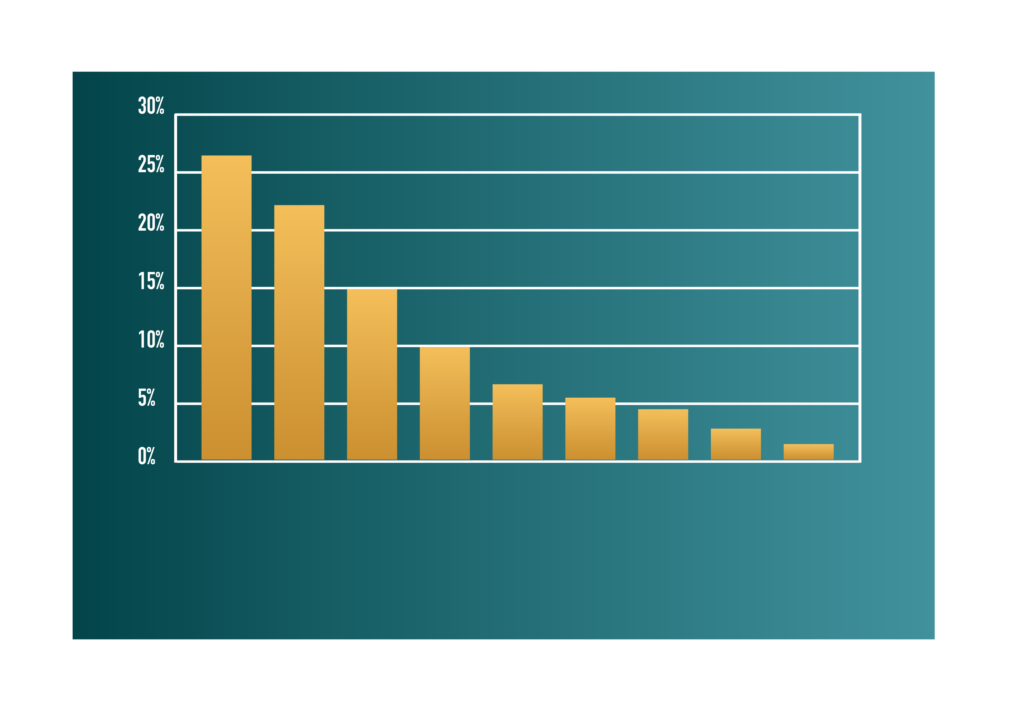
The main sectors where food waste is being generated in Ireland.
FOOD WASTE PRODUCING SECTORS
Food Retail
Education
Food Wholesale
General Retail
Hotel
Restaurant & Bars
Offices
Hospitals
Transport & Communication
(source: https://stopfoodwaste.ie/resources/business/food-waste-in-your-business )

Slide 35
Food Waste = Money Waste
WATCH
Is this happening in your Food Service business?
This is a comical video produced by Monaghan Co. Council in Ireland to encourage food service businesses to Prevent Food Waste at source. With the message…
Less food waste = more profit
foodwaste = money waste – YouTube

Slide 36
Starting Point to address – get to know the Food Recovery Hierarchy:
The Food Recovery Hierarchy prioritizes actions businesses can take to prevent & divert wasted food. Each tier of the Food Recovery Hierarchy focuses on different management strategies for food waste.
The top levels of the hierarchy are the best ways to prevent & divert wasted food because they create the most benefits for the environment, society & the economy.
At Source Reduction
Feed Hungry People
Feed Animals
Industrial Uses
Composting
Landfill/
Incineration

Slide 37
Food Waste Management
PREVENTION
Reducing the waste produced
Redistributing surplus food to humans
Redistributing surplus food (without processing) to livestock
RECOVERY
Processing waste/surplus food for livestock feed
Home composting
Energy from Waste (incineration and fuel*)
RECYCLING
Anaerobic Digestion (energy recovery system but counts as recycling for Directive)
Composting
DISPOSAL
Food disposal units to sewer /
Landfill

Slide 38
TOP TIPS for Food Service Kitchens…
Make a list – Plan your menus for the week ahead and make a list of the ingredients or stock you will need for those recipes. Order supplies from your list and order only what is in your plan, thus preventing you from throwing away unused food.
Look beyond the spots– Discolored or misshapen fruits and vegetables are usually just as tasty as their picture-perfect peers. If your supplier can’t sell them, they will likely end up being dumped. Some suppliers offer these “flawed” items at discounted prices – take advantage of them.
Know what dates mean – A best-before-date is an estimate of the food’s freshness. Many foods can be consumed safely after these dates if they have been stored properly. Examine the item but ‘if in doubt throw it out’…do not put consumer safety at risk.
Get creative – Find recipes that allow you to use an entire item, like sautéing thinly-sliced broccoli stems with the florets.

Slide 39
TOP TIPS for Food Service Kitchens…
Store food properly – Learn where food has the longest life. Some foods may perish quickly at ambient temperatures but survive for weeks when chilled. Learn how to prevent waste by freezing, cooking or pickling items so they last longer.
Save your leftovers – Make use of leftovers e.g. unused prepped vegetables can be used in soups, fish and meat bones can make the best stocks, off cuts of bread can become bread-crumbs
Stay organized – Rotate your stock regularly to bring older foods to the front, then make a plan to use them. Check your fridge regularly to keep tabs on what items should be used right away.
Track what you throw away – Keep a running list of what you most often throw away & then buy less of it or make smaller portion sizes
Donate it – If you know you won’t consume something, donate it to a food hub to help feed others.

Slide 40
Top Tips for Plate Waste Reduction
While it's a good idea to start by managing kitchen waste, it is important that as Food Service SME's you are not just handing the food waste down to the consumers, as plate waste contributes significantly to the overall organic waste in wealthy countries. Take the following steps to minimise this waste:
What gets measured gets managed – keep a separate organic waste bin for plate waste and take note of the main waste streams
Use smaller plates or serving containers or offer different sizes when serving food – this is proven to reduce plate waste.
When possible, opt for a made to order service, canteen and buffet models are proven to create more plate waste
Offer a take home service for leftovers.

Slide 41
WATCH
Bread is Gold is the first book to take a holistic look at the subject of food waste, presenting recipes for three-course meals from 45 of the world's top chefs, including Daniel Humm, Mario Batali, René Redzepi, Alain Ducasse, Joan Roca, Enrique Olvera, Ferran & Albert Adrià
Bread is Gold - YouTube
Innovative chefs like Massimo Buttura are making a name for themselves by reinventing ‘waste’.
Matt Orlando’s Restaurant Amass is being dubbed the most sustainable restaurant in the World!
Doug Mc Master is the chef and founder of Silo, the first zero-waste restaurant in London.
Using ‘waste’
Inspiration…

Slide 42
Food Waste Action Week 2021
WATCH
A UK initiative
This Clip shows the highlights of a UK initiative where WRAP and Love food hate waste joined forces to 'wake the nation up' to the environmental consequences of food waste.
Food Waste Action Week 2021 Highlights - YouTube

Slide 43
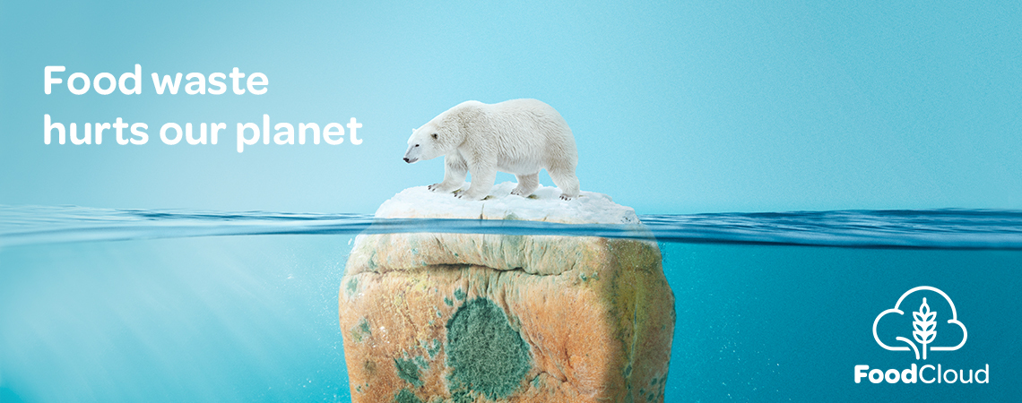
Redirecting Food Waste to those that can use it…
Food Cloud and Irish Initiative:
WATCH
Here Iseult Ward talks about why and how they set up Food Cloud in Ireland : “Transforming Surplus into Opportunity”
FoodCloud: Transforming Surplus into Opportunity - YouTube

Slide 44
What to do with our waste?
As previously mentioned, food waste is something that can be minimised but never eradicated.
For this reason, it is important that we look at utilising the circular economy in the food system and turn waste to a resource through value added processes.
If you want to learn more about the circular economy go to Module 4!

Slide 45
Useful links for Businesses to reduce Food Waste across Europe:
https://stopfoodwaste.ie/resource/top-tips-for-reducing-food-waste-in-food-service-businesses
Foodwaste | Food Waste Regulations | Food Waste Prevention : foodwaste.ie
https://foodwastecharter.ie/
https://www.cheaperwaste.co.uk/blog/food-waste-the-complete-2020-guide/
https://ec.europa.eu/newsroom/sante/items/691528
https://foodtank.com/news/2019/09/spains-first-food-sharing-app-is-tackling-food-waste/
https://www.nottingham.ac.uk/biosciences/documents/business/food-innovation-centre/food-waste-management-and-valorisation.pdf

Slide 46
MODULE 2
3. Sustainable Packaging

Slide 47
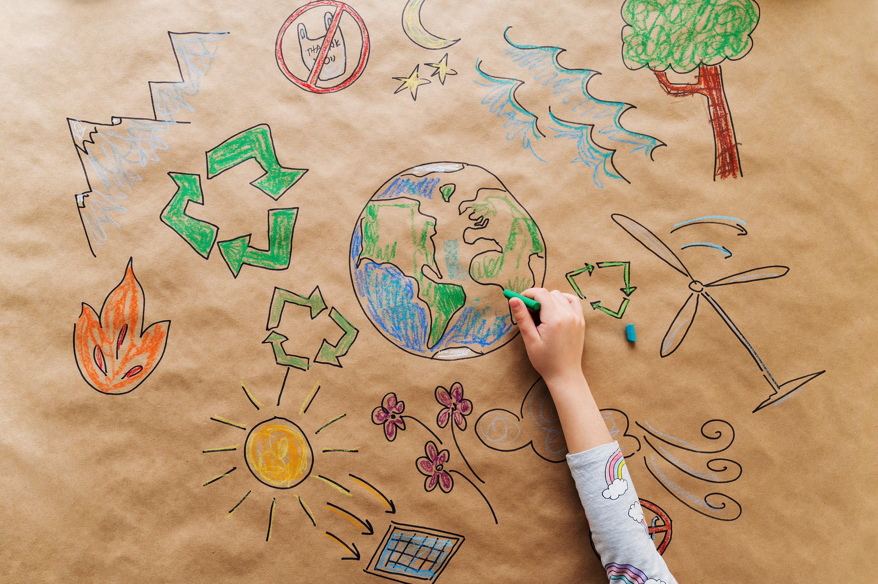
SUSTAINABLE PACKAGING
Many customers are demanding sustainable packaging these days: but what does that mean for food service businesses?
Sustainability in packaging design requires new information to be considered including:
environmental life cycle of the product and its packaging
the role of packaging in achieving sustainable development goals
packaging environmental regulatory requirements
systems in place for the recovery, use and disposal of packaging at end-of-life.

Slide 48
SUSTAINABLE PACKAGING
Designing & purchasing for sustainability requires a commitment to rethink the design of the product-packaging system. There are potential trade-offs between objectives, for example:
material efficiency of a plastic pouch vs. the recyclability of a plastic bottle or cup.
environmental benefits of enhanced recyclability vs. the cost of changing the packaging
elimination of heavy metal-based inks or pigments vs. the marketing advantage of vibrant and durable colours.
EFFECTIVE
EFFICIENT
Fit for purpose
Materials, energy, water
SUSTAINABLE PACKAGING
CYCLIC
SAFE
Renewable and/or recyclable
Non-polluting &
non-toxic

Slide 49
Raw Materials: Paper and Wood
Timber, fibre-based packaging materials & biopolymers from agricultural products can impact on biodiversity & the sustainability of natural ecosystems.
Forestry operations, for example, may reduce or damage old growth forests.
The procurement of ‘renewable’ materials needs to minimise any potential impacts; for example, by only using paper or cardboard from sustainably managed forests.
Food security issues also need to be addressed; for example, by investigating the impact of diverting food crops such as corn to manufacture packaging.

Slide 50
Covid & the shift towards take-away
As we see a shift towards more restaurants adopting a takeaway model, we decided to look at the different types of packaging so that you can stay on track and meet your sustainability goals.
There are many things to consider when purchasing food packaging, in this module we’ve broken down the most popular options and shared some information which will help you make a more informed decision on what’s best for your business.

Slide 51
Covid’s Legacy:
In recent years, we had seen significant progress in efforts to reduce single use disposables in the food service sector and a growing awareness of the impact of the volume of packaging waste produced in our industry (with great progress in particular in take-up of reusable coffee cups).
In the wake of Covid-19, we have sadly seen a massive increase in single use again, partly due to the growth in take away and eat-at-home options but also because many businesses have opted to offer more individually packaged items due to safety concerns and to stop accepting reusable cups due to concerns over contact.
The Food Safety Authority of Ireland has stated that it is not necessary to use disposables and that it is still permitted to accept reusable cups and containers from customers, provided systems are in place to ensure safety. [Source: Food Safety Authority of Ireland]

Slide 52
Contactless Coffee
WATCH
Simple safe systems…
Cloud Picker café in Dublin demonstrate a simple yet effective contactless approach to serving coffee in a reusable cup.
https://www.youtube.com/watch?v=uTyEuOSY_pY

Slide 53
The 3 Rs approach to reducing waste
1. Reduce
2. Re-use
3. Re-cycle
Reduce means using fewer resources. It includes strict avoidance as well as reduction at source.
Recycling means any recovery operation by which waste materials are reprocessed into products, materials or substances.
Reuse means any operation by which products or components that are not waste are used again for the same purpose for which they were conceived.
Notes:
I changed this from re-use reduce recycle – I think this a more widely accepted version and also fits into circularity better

Slide 54
Sustainable options:
1. Reduce
Reducing how much packaging and single use items you have in your business can also help you reach your sustainability goals as well as being good for your bottom line.
Tips:
Don’t include disposable cutlery in the bag as a default. Make it an option for people when they order. If your customers do opt for cutlery, consider how much the food requires. Do you need to include a full cutlery set or will a fork suffice?
Reduce the amount of packaging…If you’re offering burgers for example, do you need to include a takeaway box or will paper wrapping be enough to include?
You can also look at ways to encourage your customers to bring their own container. If feasible, can you offer them an incentive to bring their own bag or lunchbox container?
Consult with your suppliers about ways in which they can reduce packaging on what they send to you. Can they opt for reusable boxes? Are they able to take back the packaging for processing or reuse on their side?

Slide 55
Choosing take-away containers for your business:
What type of food will you have on your takeaway menu?
What size will the container need to be?
What type of food will they need to hold? - Is there sauce included with the dish?
What is your budget?
Where will the food be eaten?
Once you’ve thought about what the features the container will need to have, you can then take a look at what’s on offer.

Slide 56
Food that will be eaten at home:
Cardboard packaging is typically the best option.
Usually, you will find this packaging has a thin plastic lining on the inside, however, it can still be washed out and put in cardboard recycling at home, as long as it’s fully clean and free from any grease marks. Be sure to label your packaging clearly, encouraging your customers to clean before they put in the recycling bin. [Source: City to Sea]

Slide 57
Food that will be eaten out/away from the home:
Bagasse packaging is one of the most eco-friendly options currently available.
Bagasse is the waste that is produced from sugar cane plants, left over after the sugar has been extracted. These soft paper-style boxes will decompose naturally if they end up becoming litter.
Also, to note, if this packaging is brought home, it can be put in your home compost bins.

Slide 58
PLASTIC REDUCTION V FOOD WASTE
If there’s one thing we are all focused on at the moment it is the reduction of plastic in the food supply chain.
Food supply chains are complex networks with lots of parts. In Europe alone, 12m farms produce agricultural products which are processed by around 300,000 food and drink companies. These are then distributed by 2.8m food retailers and food services, serving around 500m consumers
https://www.europeansources.info/record/you-are-part-of-the-food-chain-key-facts-and-figures-on-the-food-supply-chain-in-the-european-union/

Slide 59
PLASTIC REDUCTION V FOOD WASTE
Plastic packaging is used in the food supply chain because it supports the safe distribution of food over long distances and minimises food waste by keeping food fresh for longer.
A 2016 review of studies on food waste found that 88m tonnes of food is wasted every year in the EU – that’s 173kg per person and equals about 20% of food produced
https://ec.europa.eu/food/sites/food/files/safety/docs/fw_lib_fw_expo2015_fusions_data-set_151015.pdf
https://www.foeeurope.org/sites/default/files/materials_and_waste/2018/unwrapped_-_throwaway_plastic_failing_to_solve_europes_food_waste_problem.pdf

Slide 60
PLASTIC REDUCTION V FOOD WASTE
The Debate
With its advantages of being cheap, light, mouldable, flexible and impervious to water, plastic’s unique qualities set it apart from other materials. Used in the making of a vast number of products, it now plays a central role in many people’s lives. Many contemporary packaging applications, like those used by takeaway services and pre-prepared foods, are linked to the emergence of an on-the-go culture and declining household sizes, and are often linked to higher levels of waste
However, recent estimates from Zero Waste Scotland suggest that the carbon footprint of food waste generated can be higher than that of plastic. Specifically, 456,000 tonnes of food waste produced in Scottish households were found to contribute to around 1.9m tonnes of CO₂, three times higher than that of the 224,000 tonnes of plastic waste generated.

Slide 61
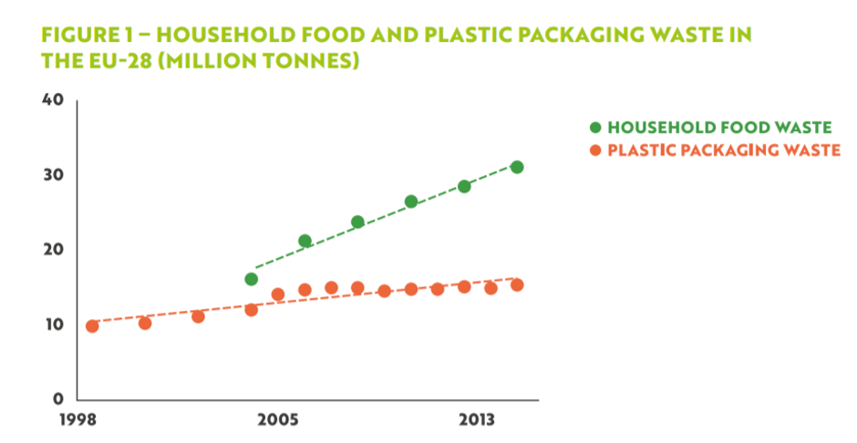
Eurostat. Packaging waste by waste operations and waste flow.
http://ec.europa.eu/eurostat/data/database?p_p_id=NavTreeportletprod_WAR_NavTreeportletprod_INSTANCE_nPqeVbPXRmWQ&p_p_lifecycle=0&p_p_state=normal&p_p_mode=view&p_p_col_id=column-2&p_p_col_count=1.

Slide 62
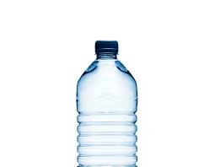
PLASTIC REDUCTION V FOOD WASTE
As the world’s foremost throwaway material, plastic has naturally being targeted in circular economy plans. These may involve design of products for ease of reuse and avoiding composite materials that are hard to recycle
Work is also being done into new, bio & natural based packaging that can perform the same role as conventional plastic in terms of protecting food and preventing food waste – and could also be biodegradable. But a lot of questions remain as to whether bio-based plastics / alternative materials are actually sustainable in the long term, especially if vast amounts of resources are needed to produce them.

Slide 63
Sustainable options:
2. Re-use
Reusables are the number one choice when looking at products and packaging.
How to increase reusables in your restaurant:
Try swapping clingfilm for reusable boxes
Introducing a small fee for disposable packaging on takeaway items. (Research has shown that a fee on using disposables will incur a better result over a reward for bringing your own packaging).
Display signs to encourage your customers to use reusable packaging and bring their own containers and cups.

Slide 64
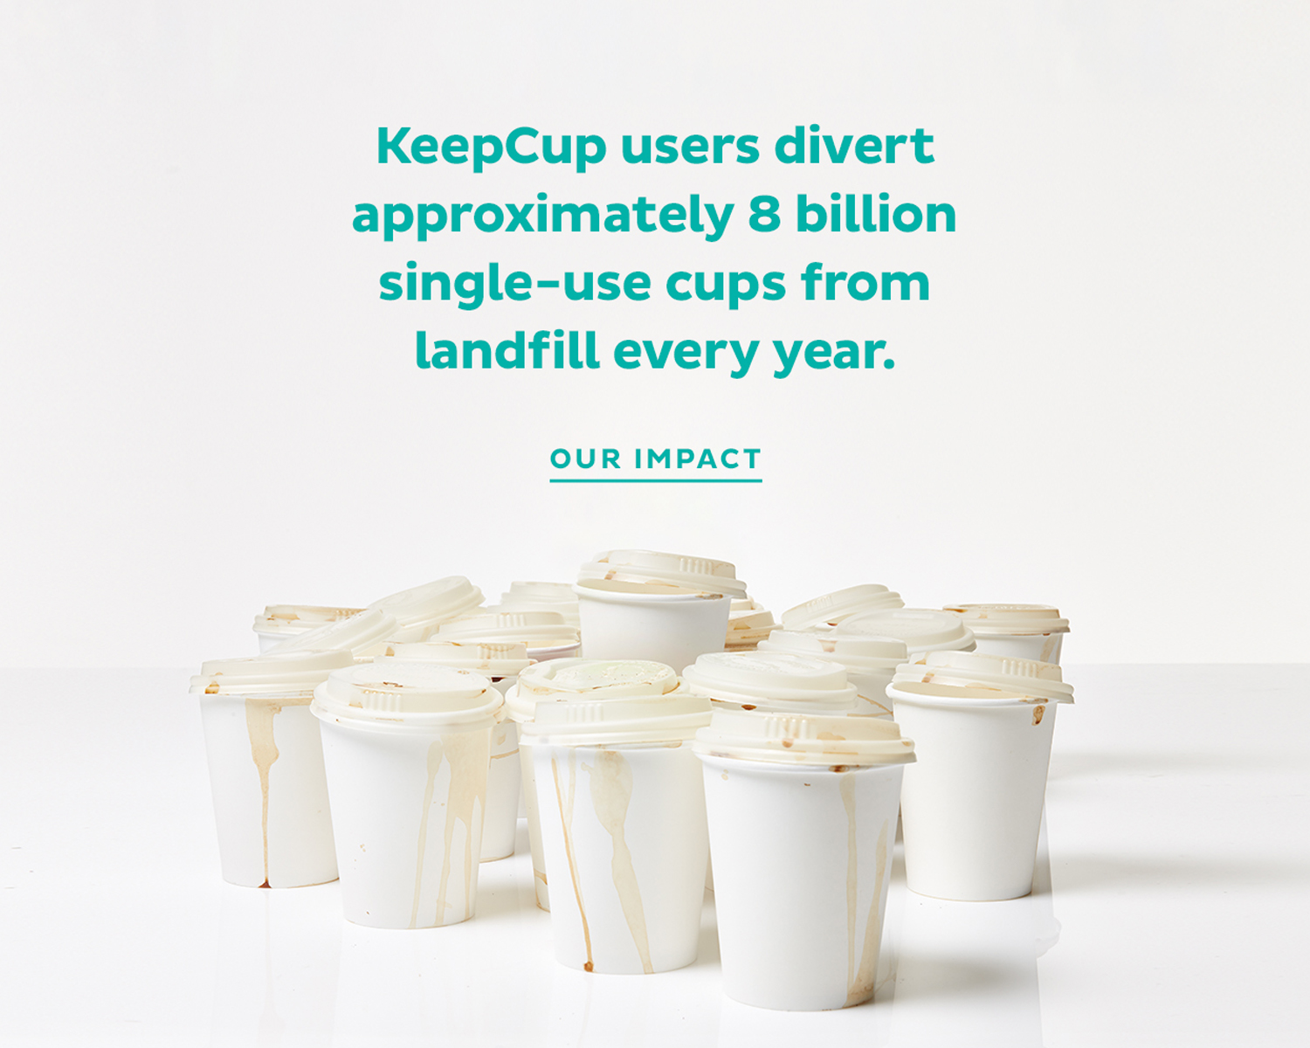

Slide 65
This Irish café is a perfect example of a business avoiding food packaging and being environment conscious. Owner Fiona leads by example at her eco-friendly, vegan café in Co. Donegal. She practices environmentally friendly, and sustainability in every aspect of the business. From sourcing her produce locally to reduce its carbon foot-print as well as knowing that the produce is grown in an ethical and eco-friendly manner to operating a zero-waste café. By ‘simply’ eliminating the use of single use cups she is making her business more ‘green’. Her menu is Vegan based promoting a lower carbon diet as well as a healthier way of life to the residents and visitors to the area.
VISIT https://www.foodinnovation.how/wp-content/uploads/2021/08/94-Simply-Green.pdf

Slide 66
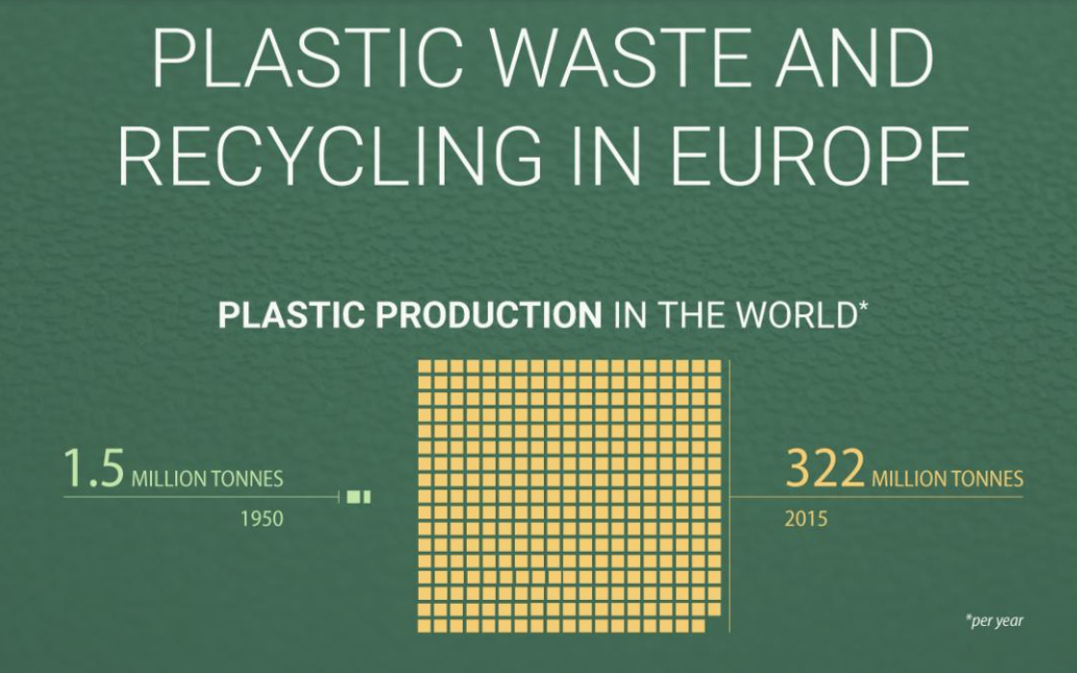
Sustainable options:
3. Recycle
Reducing and Reusing are the better solutions, but Recycling must be considered also.

Slide 67
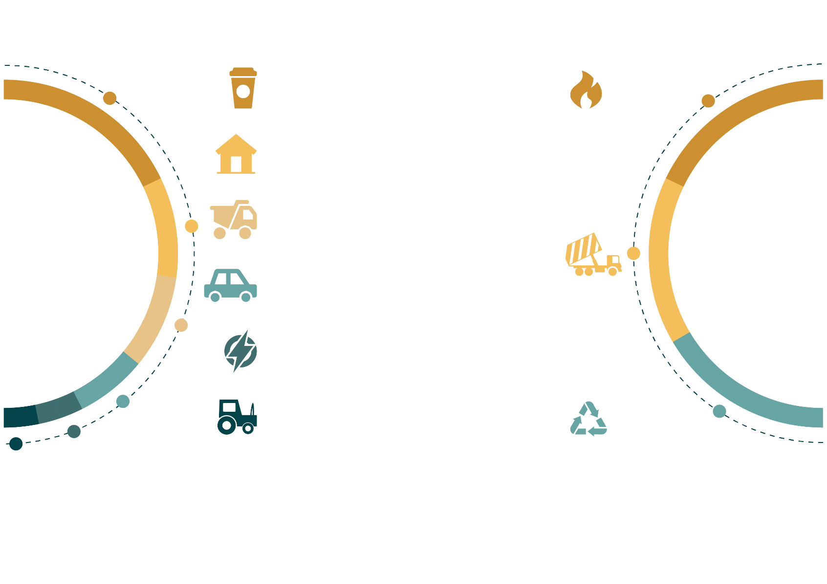
Sustainable options:
3. Recycle
IN EU MEMBER STATES
PLASTIC PRODUCTION BY TYPE
PLASTIC WASTE TREATMENT
Less than one third of plastic waste in Europe is recycled!!
Packaging is the biggest offender
40%
Packaging
39%
22%
Incinerated
Consumer & household goods
20%
Building & construction
31%
09%
Cars & Iorries
Landfilled
06%
Electrical & electronical equipment
03%
30%
Agriculture
Recycled

Slide 68
Recycling:
How can your business help?
What actually happens to the plastic if we just throw it away? E. Bryce traces the life cycles of three different plastic bottles, shedding light on the dangers these disposables present to our world.
https://www.youtube.com/watch?v=_6xlNyWPpB8&list=RDCMUCsooa4yRKGN_zEE8iknghZA&index=1

Slide 69
What is Happening in the EU…
3. Recycle
Half of the plastic collected for recycling is exported to be treated in countries outside the EU. Reasons for the exportation include the lack of capacity, technology or financial resources to treat the waste locally. Previously, a significant share of the exported plastic waste was shipped to China, but with the country’s recent ban on plastic waste imports, it is increasingly urgent to find other solutions.
The low share of plastic recycling in the EU means big losses for the economy as well as for the environment. It is estimated that 95% of the value of plastic packaging material is lost to the economy after a short first-use cycle.
Each year, the production and incineration of plastic emits about 400 million tonnes of CO2 globally, a part of which could be avoided through better recycling.

Slide 70
Recycling Tips for SMEs
While companies and communities are working to design out waste, some packaging waste can be unavoidable for SME's.
SME's can best deal with this waste by taking the approach of 'what gets measured, gets managed'
Take note of your waste streams and engage with suppliers to reduce unneccessary packaging.
While green bins typically don't accept certain types of plastic, some quick research will be able to point you in the direction of recycling centres that will accept soft and black plastics

Slide 71
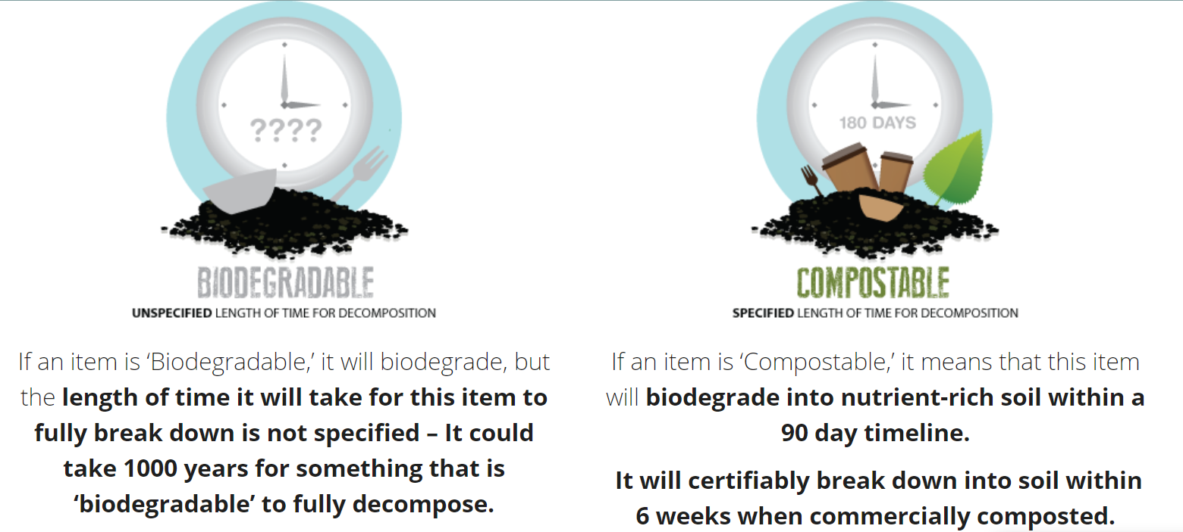
Knowing The Difference…

Slide 72
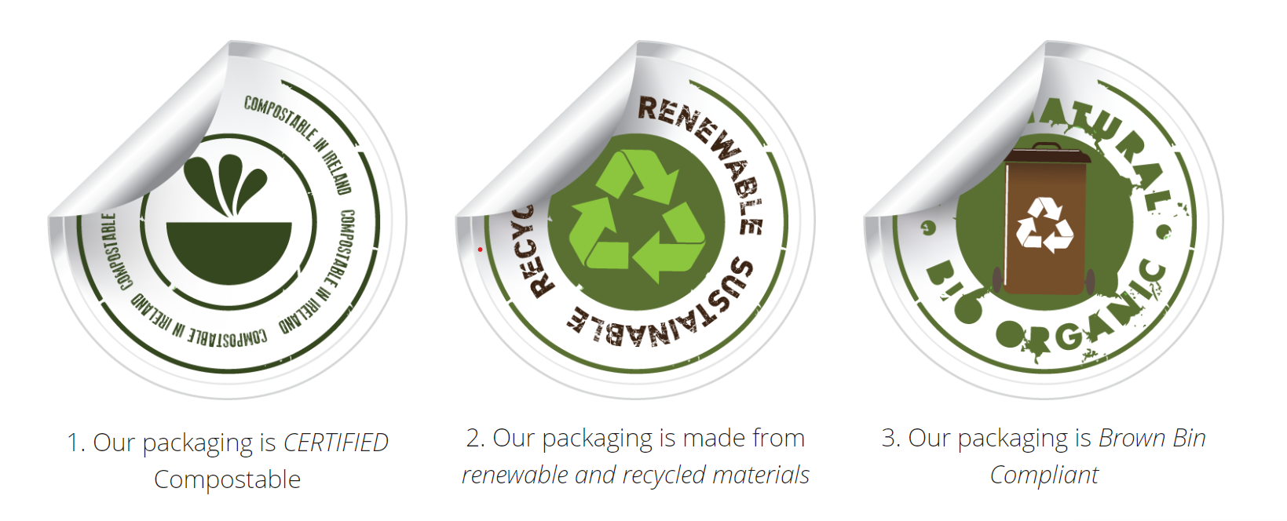
What we need to look out for…

Slide 73
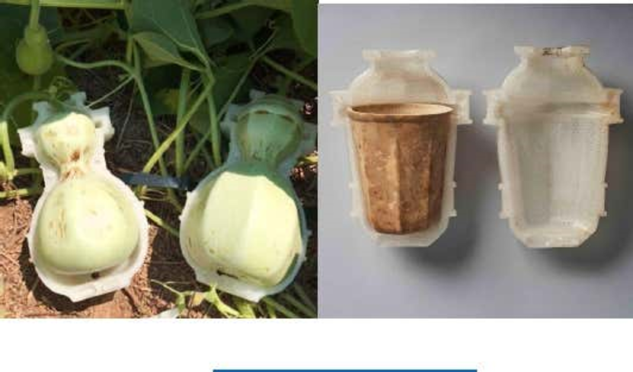
GOURD Coffee Cup Product – made from
pumpkin plants, grown in a 3d printed mould
Ecovative Design: Mycelium
Rather than being reliant on petroleum, these products use local feedstock from crop waste such as seed husks and woody biomass (which means the material can be grown anywhere and is 100% compostable). Mycelium is the root structure of mushrooms and, as it turns out, is a wondrous and versatile product: MycoFlex in which, as the name suggests, flexible mycelium provides sustainable alternatives to everything from plastics to leather; and MycoComposite in which the mycelium serves as biodegradable packing material
Seaweed based ‘plastic’ film.

Slide 74
WASTE REDUCTION
As already mentioned Waste reduction and waste management strategies are equally important for the food service industry – and important to customers who demand that their preferred suppliers benefit the environment and are socially responsible.
Source reduction or waste prevention is the most effective way of reducing the environmental impact of your food service because it prevents unwanted and unnecessary materials from being created.

Slide 75
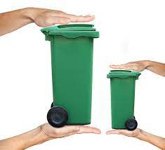
WASTE REDUCTION
Benefits of a waste prevention strategy include:
Cost savings by avoiding the purchase and disposal of unneeded food and packaging products
Reduced environmental impacts over the lifecycle of a product associated with:
Food and packaging production (including fertilizer and pesticide use, water pollution, air pollution, energy use, and greenhouse gas emissions)
Transport of food and waste products (including energy use, air pollution, and greenhouse gas emissions from vehicle travel)
Disposal (including landfill methane emissions, water pollution).

Slide 76
PLASTIC WASTE REDUCTION/AVOIDANCE…
What Food Service Industry can do to help:
Including packaging reduction in a purchasing policy will also help reach reduction and cost saving goals:
Purchase products in returnable containers
Purchase supplies in recyclable containers
Buy supplies with short supply chains and avoid the plastic packaging that way
Select re-useable or compostable instead of disposable service ware: cutlery, stirrers etc
Encourage your customers to bring their own containers

Slide 77
PLASTIC WASTE REDUCTION
Consumers’ feelings…
Many European consumers are frustrated with current levels of food packaging. In a survey by UK consumer watchdog ‘Which?’, 94% of respondents agreed that manufacturers and supermarkets should act to reduce the amount of packaging used in their products, 54% said that they try to purchase products which are not over-packaged and 23% reported excess packaging as a reason to avoid buying a product.
(Which?, Which? unwraps packaging in supermarkets, in Which? Magazine. 2011, Which?: London, UK)
Remember:
The most environmentally friendly packaging = No Packaging

Slide 78
A case-study to show how packaging can be avoided:
These vending machines in the Basque region of Spain, offer consumers a new way of purchasing fresh milk and dairy products. These machines are empowering the community to choose the quality and quantity they want. The vending machines also eliminate packaging as customers provide their own receptacles. The short supply-chain and direct selling cuts costs and means the local farmers will become more sustainable.
VISIT https://www.foodinnovation.how/wp-content/uploads/2021/08/83-Organic-Dairy-Vending-Machines.pdf

Slide 79
ACTIVITY…The way Forward
Cost Benefit Analysis: Activity
Think about your service and what you offer – how could a bring-your-own service enable you to save packaging and money
Following New Legislation: Soon it will be compulsory
https://www.irishtimes.com/news/environment/reuse-repair-recycle-circular-economy-legislation-set-to-have-huge-impact-1.4597151

Slide 80
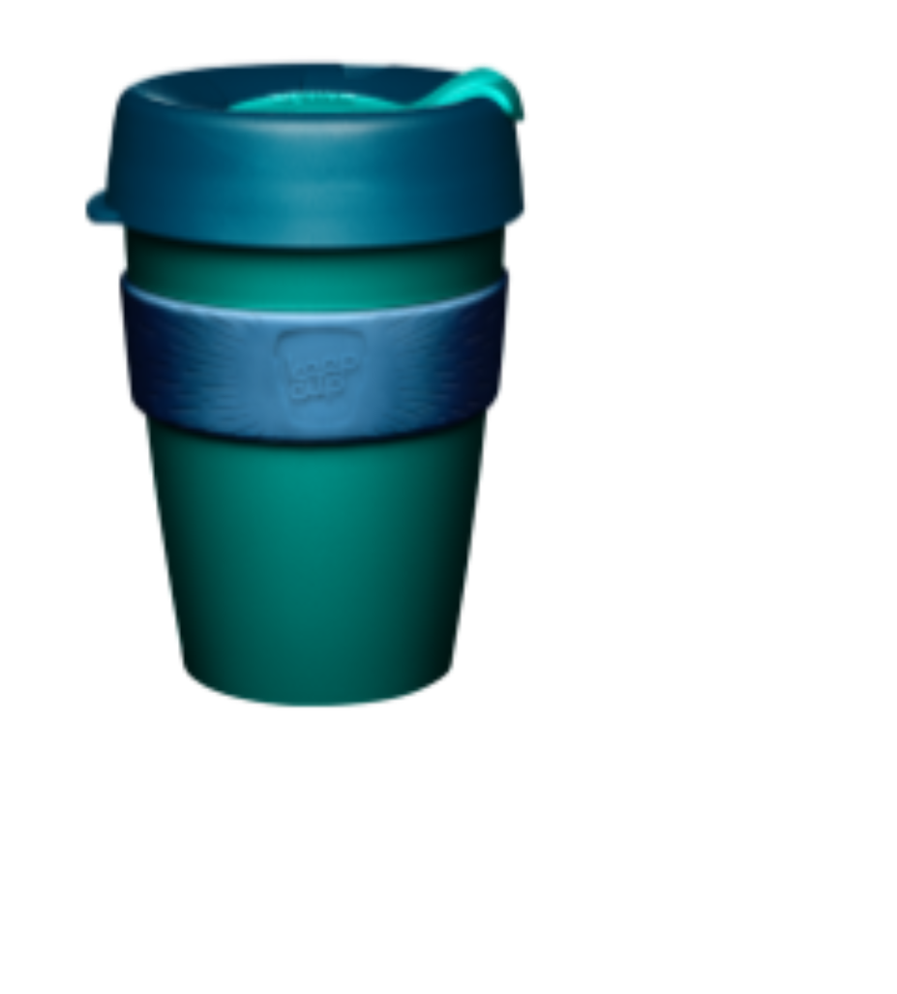
ACTIVITY: CBA Example
EXAMPLE: “BRING YOUR OWN” COST ANALYSIS
ASSUMPTIONS:
$0.15 Cost of disposable packaging (cup, lid, and sleeve)
$0.10 Discount for “bring your own” cup
12 hours Daily operating hours
RESULTS
No. of “bring your own” per hour | Daily cost savings | Annual cost savings
3 | $1.80 | $657
10 | $6.00 | $2,190
No. of “bring your own” per hour | Annual greenhouse gas reduction (lb.CO₂ equivalent) * | Annual solid waste reduction (lb.) *
3 | 339 | 378
10 | 1130 | 1260

Slide 81
UK PLASTICS PACT
UK PLASTICS PACT has issued very good guidelines on choosing sustainable packaging in the food service sector:
https://www.wrap.org.uk/sites/files/wrap/Considerations-for-compostable-plastic-packaging.pdf#page=16

Slide 82
ACTIVITY-Checklist:
Food Trends in the Era of Climate Change
Readiness checklist:
Are you using sustainable packaging? ⃝
Are you promoting reuse & reduce? ⃝
Is your business recycling correctly? ⃝
Are you avoiding the use of plastics? ⃝
Do you provide alternative protein options on your menu ? ⃝

Slide 83
Thank You!

