Slide 1
Module 5
Technology For Food Service & the Future

Slide 2
01
Contactless Services
Module 5
02
Big Data
Advances in technology and communications are changing the way we find, eat and dispose of our food. Since the start of the COVID-19 pandemic, the adoption of new technologies has been key for food sector businesses survival.
The food service sector plays an important role in shaping food sector trends as they act as intermediaries between producers and consumers.
03
Demand Driven Delivery
04
Retail Products
05
Marketing

Slide 3
Technology and communications are changing the way we find, eat and dispose of our food
Restaurants, cafes and caterers adopting new food trends, does not only present their customers with an opportunity to consume their product, but also as an opportunity for consumers to engage with, and learn about the latest trends in the food industry. (Food for Life)
Despite being one of the largest employers in Europe, 70% of food service/ SMEs said they didn't engage in any Research and Innovation, with only around 20% saying they'd be willing to test new or existing technologies available to them. (Food for Life)
As key drivers of change in the sector, it is important for food service businesses to constantly be looking to innovate.
"Research and innovation (R&I) are key drivers in accelerating the transition to sustainable, healthy and inclusive food systems" (Farm to Fork Strategy)

Slide 4
The reluctance to embrace change
This is routed in a number of concerns:
Lack of time and finances
A low innovation awareness due to lack of information on emerging technology
A lack of management skills needed to carry out Research & Innovation on top of day- to- day business operations
Scepticism and unease with new and non-traditional business models
Fear of losing customers and employees
[Source: Food for Life]

Slide 5
Food Service Technologies
Due to these limitations to innovation in food service SMEs, it is important that opportunities for collaboration between technology companies and SMEs are developed. [Source: Food for Life]
In this module, you will be introduced to some of the key areas where technology is being implemented and how certain technologies are offering easily implementable technology solutions for SMEs in the food sector. Your learning will increased through specific case studies of food service businesses who have adopted these processes, meeting the needs of the consumer.
Notes:
Link to source:
https://www.prnewswire.com/news-releases/rise-of-contactless-dining-anticipating-food-service-industry-says-brandessence-market-research-301198600.html

Slide 6
QUICK EXERCISE:
BEFORE WE PROCEED WITH THIS MODULE
Can you make a list of technology systems you are AWARE of in the Food Service Industry?.....................................
Then list any form of technology that is currently being USED in your Food Service Business………………………………….

Slide 7
MODULE 5
1. Contactless Services

Slide 8
Contactless Service
Due to the COVID-19 pandemic we have seen a rapid increase in the adoption of contactless services in the Food Service Sector.
While contactless payment systems were growing steadily, this contactless revolution spread to the utilisation of contactless menus, ordering and delivery of food to ensure that contactless approaches in the food service sector will continue to grow.
Notes:
Link to source:
https://www.prnewswire.com/news-releases/rise-of-contactless-dining-anticipating-food-service-industry-says-brandessence-market-research-301198600.html

Slide 9
Contactless Technologies
While this contactless service transition became a necessity from 2020 onwards, there has been several technologies developed over the last couple of decades that have facilitated contactless processes. They have recently become more prolific in the food industry as technology companies have adopted their capabilities and provided smart technology services to food service businesses.

Slide 10
QR Codes
QR (Quick Response) codes are over 25 years old but have only come into widespread adoption during the COVID-19 pandemic.
Their ability to be scanned easily by smart phones makes their convenience ideal for supplementing traditionally contact heavy processes within the food system. They have been adopted in abundance across industries and processes as digitalization has accelerated.

Slide 11
Contactless Menus
This increased demand for contactless services has led to an emergence of contactless menu's that utilise QR codes to direct customers to their websites where they have their menu for the day displayed.
This use of tech gives customers the peace of mind to eat out without the risk of contracting the virus.

Slide 12
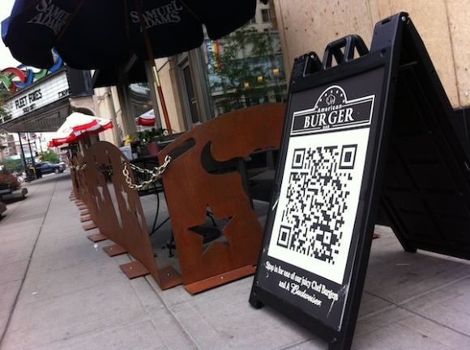
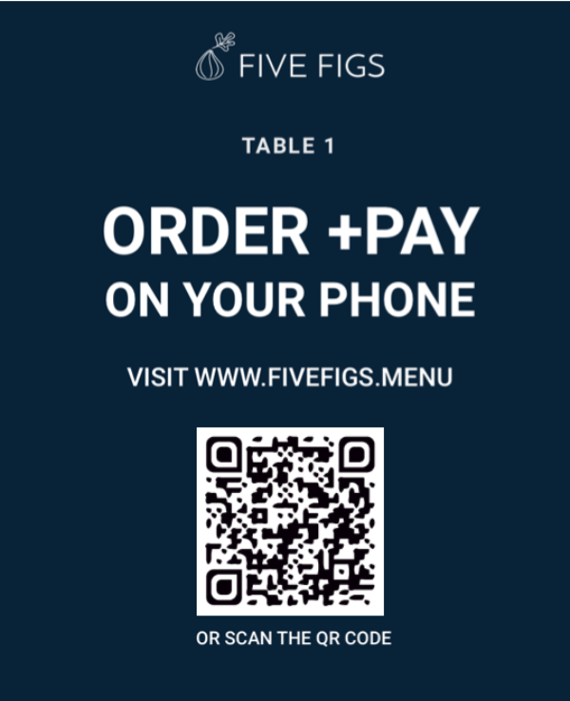
Example uses of QR codes
There are four primary ways to use QR codes in the food service sector:-
QR code menus - growth of touchless menus that use QR codes.
Promotions and deals
Unique information, and personalization
Marketing
Take Note!
Whilst there are a number of apps to create a QR code, we found that www.qr-code-generator.com is very user friendly and intuitive to use.

Slide 13
Contactless Ordering
Technology companies such as 'Flipdish' have facilitated this transition by creating easily implementable ordering through the further use of QR codes, improving efficiency and reducing contact points for food service providers.

Slide 14
Near Field Communication (NFC)
Near Field Communication (NFC) is a technology that allows close-proximity communication between two electronic devices.
Most popularly used for contactless payment services, it is a further enabler of the rapid transfer of information that facilitates increased insights for businesses and consumers alike.
NFC technology can be found throughout the food production and service system for these data capabilities

Slide 15
Radio Frequency Identification (RFID)
Radio Frequency Identification (RFID) is another contactless enabler of data transfer.
RFID works through the utilisation of magnetic fields to track small tags attached to different objects.
These tags can link to extensive information about the items being tagged making RFID an important asset in creating a more contactless means of inventory and supply chain management.

Slide 16
Contactless Payment
Contactless payment systems are now universally accepted across Europe.
Utilising NFC technology it is now possible to complete transactions safely and more efficiently than before using a card or a smart phone.
This transition towards a contactless future has seen the rise of Point-of-Sale system companies such as 'Square' and entirely online banks such as 'Revolut'.

Slide 17
The Benefits...
The normalisation of contactless food services produces results for food service businesses outside of reduced risk of COVID transmission.
The utilisation of tech results in faster table turnover, reduced costs, increased adaptability as well as feeding into already existing restaurant software systems which in turns provides gains through the utilisation of Big Data.
Notes:
Link to source:
https://www.prnewswire.com/news-releases/rise-of-contactless-dining-anticipating-food-service-industry-says-brandessence-market-research-301198600.html

Slide 18
Reflection:
After learning about some of the options and benefits of contactless systems…
In your learner workbook:
List 3 additional benefits of contactless systems for the Food Service Industry

Slide 19
MODULE 5
2. Big Data
& its implementation in the Food Service Industry

Slide 20
What is Big Data?
In layman's terms, Big Data is basically the science of collecting massive amounts of data and converting it into smaller chunks of manageable information that can be used to gain extensive and relevant insights on a subject.
In many cases, owners of food service businesses don’t pay attention to the wealth of information they have on processes and consumers.
We are going to explore how you can utilise this information in order to provide a better service, streamline your business processes and better meet market needs.

Slide 21
Big Data in the Food Sector
Data is a resource in the Digital World. It is said data is the new gold! Big data is information taken from all aspects of life and used to provide better systems and services and more even more tailored communications. By engaging with Big Data, food service businesses stand to gain in some key areas.

Slide 22
Advantages of Big Data in the Food Services Sector
1. Quality Control
2. Enhanced Efficiency
3. Improved Insights
Monitoring the Supply Chain
Improved Shelf-Life prediction
Big Data helps the food industry improve processes through better prediction and control
Improved market fit through predictive analytics

Slide 23
1) Quality Control
The use of Big Data and data analysis is hugely important in ensuring the quality of food being served.
Smart technologies that we mentioned earlier (NFC, RFID, QR code), artificial intelligence and blockchain technology can be used to track products throughout the supply chain.
This ensures cold-chains, and the authenticity of produce is met and consequently the best produce reaches the food service supplier

Slide 24
Blockchain in the Food Sector Supply Chain
WATCH
The benefits…
In this video, Director of Smartbridge, Matthew DiBona explains the breakdown of the food supply chain & how integration of blockchain in the food service industry can transform the way humans consume.
Blockchain in the Food Service Industry - Blockchain for Business Video Series - YouTube

Slide 25
Quality Control
You may be aware, there are several companies provide commercial kitchen appliances and systems which carry out automatic and digital inventory.
This Data collected gets fed back into the cloud where the companies use this information to provide better shelf-life information for the kitchens and improve provisioning.
One such project is the Elika Jan Project in Spain where technology is being used to improve the storage and shelf life of products
READ 101-Elika-Jan-Project.pdf (foodinnovation.how)

Slide 26
2) Enhanced Efficiency
Food service SMEs traditionally operate on a tight bottom line and so small gains in business operations are hugely important.
By food service businesses utilising smart technologies, they gather information from their operations and feed them back them into existing data.
The process of collating and analysing this data is highly complex so technology service providers carry this out and supply the SME with concise recommendations on how they can improve.

Slide 27
Example: Winnow
One company which uses technology and big data to improve insights is Winnow.
Winnow uses a smart bin which both weighs waste as it is being disposed of and utilises Artificial Intelligence (AI) to identify the waste source.
Through analytics, Winnow then feeds insights back to the SME on how they can reduce their waste, creating a more sustainable model and reducing inefficiency for the business.

Slide 28
IKEA – Winnow
WATCH
Food waste is a complex issue, but IKEA & Winnow are proving the solutions to the problem are possible. IKEA UK&I forged a path as the first business in the world to bring AI into its kitchens to fight food waste.
IKEA and Winnow building the kitchen of the future - YouTube

Slide 29
Example: Leanpath and Tenzo
Other companies, notably LeanPath and Tenzo, offer similar solutions.
But while offerings like these could go far in helping restaurants curb food waste in the back of house, they don’t yet address what to do about all the post-consumer food waste that piles up in restaurants — that is, the leftovers on our plates.

Slide 30
3) Improved Insights
Point of Sale (POS) services is a growing area as food service businesses try to incorporate more advanced ICT in their day-to-day activities.
Certain companies are taking this to the next level. Companies such as 'Toast' and 'Avero' are providing integrated software systems that gather data points from throughout operations and provide insights to owners which allow them to optimise their businesses.

Slide 31
Heard of IoT and IoB ?
The Internet of Things or IoT and the Internet of Behaviour IoB are both key aspects in the role of Big Data in the food sector. The IoT is used to explain how a network of interconnected ‘smart’ physical objects collect and exchange information and data over the internet. Smart devices are now prevalent throughout kitchens and restaurants whether it be Point of Sale units, smart fridges, AI in kitchens or Apps for consumers, the opportunity to collect data is everywhere.
IoB refers to how this Data is analysed through a behavioural psychology lens in order to gain valuable insight into consumer behaviours, which in turn help companies reach consumers and offer a better market fit.

Slide 32
Internet of Things
The 'Internet of Things' (IoT) refers to how a network of interconnected physical smart objects can communicate with each other and collect and exchange information and data over the internet.
Within the food service industry, these objects can include customers smart phones, POS systems, table management systems and smart kitchen appliances.

Slide 33
Internet of Behaviour
This Data collected about consumers and processes from the interconnected devices can be highly valuable. The 'Internet of Behaviour' (IoB) refers to how this data is analysed through a behavioural psychology lens in order to learn about consumers interests and preferences and in turn optimise their products for user experience.

Slide 34
Toast
Toast along with companies such as Avero POS Integrations - Avero (averoinc.com) have taken the POS system business model and seen the capabilities of technologies such as Big Data and IoT in the food service industry.
They have designed integrated restaurant systems that gather metrics across all processes of the business, from payroll and scheduling, to inventory and ordering, right through to table booking and payment.
They can then provide unique insights to business owners that previously would not have been possible.

Slide 35
Avero
Utilising Big Data & technology to provide better insights for SMEs
WATCH
Restaurants are getting a taste for data analysis. The technology can point out hidden trends & opportunities. Alex Wagner chats with Avero founders, whose data company now has thousands of restaurants as clients.
Impact of analytics on restaurant industry - YouTube

Slide 36
MODULE 5
3. Food Delivery
Demand Driven Delivery

Slide 37
Food Delivery
Restaurant takeaway and delivery food has traditionally been reserved for fast food restaurants which serve food of poor nutritional value at a lower price point. Yes, a generalization, but true!
Businesses who produce large volumes of affordable food at an affordable price point as well as large franchises were typically the only food service businesses to provide a delivery service due to some key barriers to entry for more high-end and healthy food providers.

Slide 38
Barriers to adopting a delivery model
Unpredictable Pricing Model - As food service businesses do not possess the ability to predict demand, fluctuations in the cost of deliveries can be high and so restaurants must account for this by using higher margins which is not always possible.
Logistics dilemma – An extension of the unpredictability issue, the logistics of a restaurant providing its own delivery service presents issues from staffing, to areas served, to inability to deal with volume
Inconsistency in food Quality – By extending the distance from pan to plate it can be hard for restaurants to provide the same food experience for takeaway and sit in diners
Fear of Reputational Damage is a factor for many food service businesses that rely on customer loyalty due to the risks outlined above

Slide 39
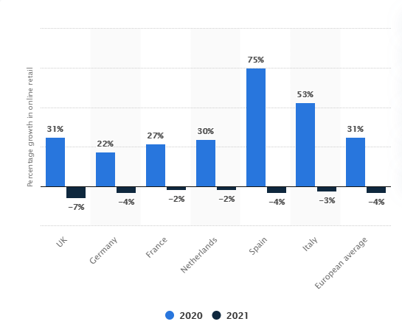
Year-on-year growth in online retail sales in 2020 and 2021
The pandemic experienced throughout 2020/21 has led to several forced experiments across industries, including food service
While certain segments of customers previously would have been reluctant to adopting online shopping, businesses were forced to pivot, and customers were forced online.

Slide 40
Second Party Food Delivery
Through the pandemic second-party food delivery providers gained popularity as consumer perceptions of online purchasing shifted and consumers became willing to take on a delivery premium to receive a socially distanced dining experience.

Slide 41
Demand Driven Delivery
Large delivery companies such as Just eat, Deliveroo and Uber Eats offer delivery at the cost of the consumer. Thus, they help overcome the barriers previously discussed by making use of economies of scale & a number of emerging technologies.
Big Data and Artificial Intelligence can be used to monitor key elements such as traffic, weather, change in routes, distance and predicted demand to ensure deliveries are met promptly.

Slide 42
Virtual/Ghost Kitchens
The emergence of virtual/ghost kitchens with digital marketplace through technology solutions has made the establishment of delivery services for small businesses more accessible and opened-up a new revenue stream.
Certain businesses are now opening over-flow kitchens with some new businesses operating a delivery only model that avoids the costly overheads of traditional sit-in restaurants.
This offers a more cost effective and lower risk route to market for small business owners.

Slide 43
Robotics and Automation
Automation refers to the use of machines and software to perform tasks that were previously done by a human. It has long been predicted that automation will replace simple monotonous tasks for labourers.
With the growth in self-driving technology, delivery looks to be one of the first activities to become automated with businesses already experimenting with it such as Uber and Manna

Slide 44
Use of Robotics
WATCH
Drone Delivery in Ireland
RTE Nationwide coverage of Manna Drone, which is trialing Food and beverage Delivery in Oranmore, Galway, Ireland
Manna-more - YouTube

Slide 45
MODULE 5
4. Retail Products
Opening revenue streams

Slide 46
Opening Revenue Streams
Beyond delivery-only kitchens, some food service operators are exploring virtual brands that can be run out of their existing restaurant kitchen.
These are typically brands that only “reside” in cyberspace, but that are made and delivered from existing space.
This provides restaurants with additional sources of revenue, particularly during slower times.

Slide 47
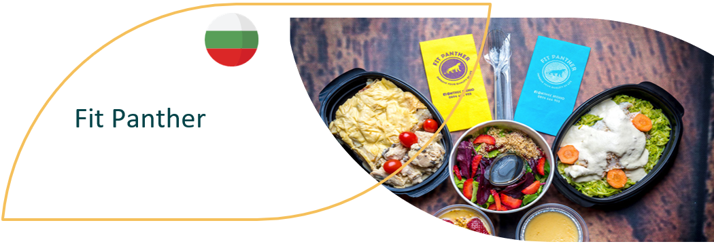
CASE STUDY – BE INSPIRED
Showing Delivery solutions & Digitalization
The mission of Fit Panther, Bulgaria is to improve quality of life. They deliver high-quality food made from selected and organic products and deliver it ready for consumption to the home, office, or wherever a client wants, within the city of Sofia five days a week. Fit Panther is a healthy kitchen, offering lunch and full-day menus, tailored to the personal needs of their busy customers and in doing so are promoting health in an innovative way and via online platforms, demonstrating how digitalization can help with a business’s sustainability and goals.
READ 37-Fit-Panther.pdf (foodinnovation.how)

Slide 48
Due to the restrictions on sit-in Dining in 2020/21, as mentioned in Module 1, we have seen food service and food delivery companies alike facilitating takeaways which has led to SME's offering a whole range of premium retail products that are made available for collection that previously would not have been possible.
Creating alternative revenue streams

Slide 49
Meal-kit Boxes
Meal Boxes are one of the most popular retail products restaurants are now offering as an alternative to delivery. The cook at home option offers customers a fresh fine dining experience at home by providing instructions through social media and fresh ingredients.
EXAMPLE: Home (thedoughbros.ie)

Slide 50
MODULE 5
5. Marketing
Technology for Customer Engagement

Slide 51
Customer engagement...
While we have discussed the individual implementation of technologies in the food service industry, it is important to also consider the transformative effect technology has had on the onboarding and retention of customers.
Technology stretches further than streamlining business operations and now serves as the primary communications intermediary between businesses and their customers.

Slide 52
Integrated Applications
So far in this Module, we have covered several key utilities of tech in the industry. Food service businesses are now offering extensive features from food delivery to table booking, therefore, many have elected to create a centralised platform in the form of an application and/or website.
The internet has changed how customers interact with products and customers now seek more information before purchasing and so businesses can use this platform to facilitate this engagement.

Slide 53
CASE STUDY – BE INSPIRED
Camile Thai
Ireland based restaurant chain, Camile Thai noticed a growing consumer demand for more information. They built an App that provides customers with a unique experience.
Typically getting traffic to the App from social media and customers using the delivery feature, Camile Thai provides further information about their product from sustainability efforts to nutrition, even offering a feature that allows you to link your meals to a fitness tracking app.
READ THE FULL STORY 5.-Camile-Thai.pdf (foodinnovation.how)

Slide 54
Social Media
Social media has become an essential part of all food service business marketing strategies. Due to the social nature of a dining and food experience, typically shared with friends and family, encouraging customers to engage with social media is an important way of attracting new customers.
The prospect of gaining online traction through customers has led to many businesses adapting their product to make it more visually appealing and creating an experience.

Slide 55
CASE STUDY – BE INSPIRED
SALATERIA SOUPS & SALADS
SALATERIA in Bulgaria use technology to inform their customers of their offerings and to educate them in relation to good food and nutrition. They have also adapted their website to cater for online sales and food deliveries as a result of the pandemic. They offer cashless transactions in store and online and have starting using the Foodpanda platform to operate their delivery service. Foodpanda is a platform for online food ordering and a site which connects users with more than 1,000 restaurants in 23 Bulgarian locations.
READ MORE 35-Salateria-Soup-and-Salads.pdf (foodinnovation.how)

Slide 56
Learner Exercise:
It has been discussed how the importance of Social in the Food Industry is increasing:
In your Learner Workbook LIST:
How many platforms your business has a presence on?
How frequently you post?
Could you interact more frequently?
Are you tracking the activity of your accounts and where can you improve?

