Slide 1

Learner
Workbook
This supplements the Sustain Modules 1-6

Slide 2

SUSTAIN Learner’s Workbook
PLEASE USE THIS WORKBOOK TO CAPTURE THE KEY LEARNINGS FROM OUR CLASSROOM COURSE
OUR FREE CONTENT CAN BE DOWNLOADED ON https://www.foodinnovation.how/resources/
This Learner Workbook follows the 6 modules of the Sustain course in sequence.
This course aims to empower food service SMEs with the innovation knowledge and skills to introduce healthy, affordable products to market, thus boosting their competitiveness and contribution to a healthier society.
Ready to get started?
Join our online social media community of SMEs, VET, interested stakeholders as well as policy makers.
https://www.facebook.com/SUSTAINFoodService

Slide 3
Content Module by Module
01
Food Service & Customer behaviour
02
Food Trends In an era of Climate Change
03
Improving Natural Nutrition / Functional Foods
04
Local & Short Supply Chains
05
Food Technology for Food Service
06
Transformational impact of food technology

Slide 4

SEE, BE INSPIRED, AND LEARN…
See how pioneering food service companies are innovating in new ways, through new food offerings, healthy options, packaging, and delivery.
Be inspired by trends & businesses who have successfully innovated their food service business through a short supply chain or adoption of technology.
Learn more about sustainable local sourcing & how you can make changes to your food service business
You have to learn the rules of THE GAME
and then you have to play better than anyone else
Albert Einstein
Innovation for the Food Service Sector!

Slide 5

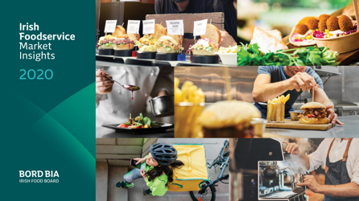
LET’S GET STARTED WITH… Module 1: Food Service & Customer behaviour
In this first learning section, we put the spotlight on the consumer. Their changing behaviour needs to be at the core of business planning so that food service operators can both recover and future proof their businesses.
LEARNING ACTION: Immerse yourself in these fascinating reports! Slides 5 and 6
EIT-Covid-19 impact on consumer food behaviours in Europe
Bord Bia Irish Food Service Market Insights Report 2020

Slide 6
Module 1:
Slides 7-17
How many of these trends / actions impacted your food service business in the last 18 months?
Think ahead to post-survival mode, assess the profitability of continuing each new service introduction
In hindsight, what would you have done differently to adapt your business model?
What new approaches make sense and profit to bring forward into the future?
_____________________________________________________________________________________________________________________________________________________________________________________________________________________________________________________________________________________________________________________________________________________________________________________________________________________________________________________________________________________________________________________________________________________________________________________________________________________________________________________________________________________________________________________________________________________________________________________________

Slide 7

BE INSPIRED – check out our SUSTAIN Case Studies
Baked in Brick
Adapting during Covid. Use of technology was key. An App investment is now a strong sales channel for the business.
Read the full story:
102-Baked-In-Brick.pdf (foodinnovation.how)
My Goodness:
An example of a food service business focusing health & nutrition in very innovative ways
Read the full story:
41-My-Goodness.pdf (foodinnovation.how)
Greenbox Food Co.
An example of how a plant-based business successfully pivoted to off-premise approach
Read the full story:
72-Greenbox-Food-Co.pdf (foodinnovation.how)
Royal Nature:
This food service business inspires people to eat healthier and demonstrate how digitalization is very effective.
Read the full story:
104-Royal-Nature.pdf (foodinnovation.how).
Kodila- Gourmet Ham Shop:
Kodila Gourmet Ham are an excellent example of the “less but better” ethos.
Read the full story:
2.-Kodila.pdf (foodinnovation.how)

Slide 8
MODULE 1 REVISION ACTIVITY:
CHECKLIST:
Is your business ready for the future / FOODTURE? ⃝
Do you know what your customers want? ⃝
Do you think your customers have the correct perception of what you offer? ⃝
Have you created a brand for your business? ⃝
Are you willing to adapt or pivot as required? ⃝
NOTES…SELF REFLECTION, HOW TO BE BETTER PREPARED:
_____________________________________________________________________________________________________________________________________________________________________________________________________________________________________________________________________________________________________________________________________________________________________________________________________________________________________________________________________________________________________________________________________________________________________________________________________________________________________________________________________________________________________________________________________________________________________________________________
______________________________________________________________________________________________________
______________________________________________________________________________________________________
______________________________________________________________________________________________________

Slide 9

Other RECOMMENDED reading from Module 1
Kerry ConsumerFirst
A survey by Mondelez
Mintel, under the “less but better” philosophy
The formulation and evaluation of culinary success factors (CSFs) that determine the palatability of food - Klosse - 2004 - Food Service Technology - Wiley Online Library
White-Paper-How-Our-Senses-Interact.pdf (leatherheadfood.com)
Why We Eat: Food, Emotions & Connection (stevegranthealth.com)

Slide 10
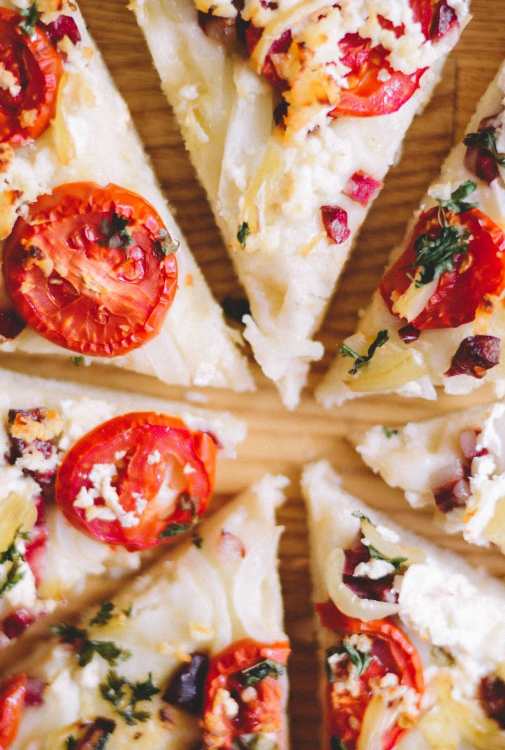
Building a Sustainable future together for People, Planet & Profit

Slide 11
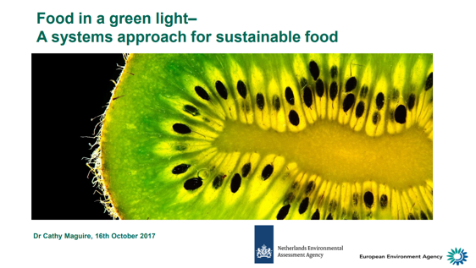
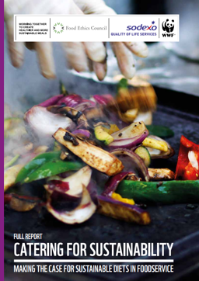
Module 2: Food Trends In an era of Climate Change
In this learning section, we will learn about Climate Change & how as Food Service providers we can have an impact by the actions we choose to take.
We focus on 3 key topics:
Food & the Environment
Reducing Food Waste
Sustainable Packaging
LEARNING ACTION: Immerse yourself in these insightful reports!
Food in a Green Light - A systems approach for sustainable food (Dr Cathy Maguire)
Food Ethics Council – WWF report on creating healthier & more sustainable meals

Slide 12
Module 2: Slides 26-40
Reflect on your performance of :
What gets measured gets managed – keep a separate organic waste bin for plate waste and take note of the main waste streams
Use smaller plates or serving containers or offer different sizes when serving food – this is proven to reduce plate waste.
3. When possible, opt for a made to order service, canteen and buffet models are proven to create more plate waste
4. Offer a take home service for leftovers.
Can you see areas of change that may be possible in your Food Service Business?
Make notes on those options:
________________________________________________________________________________________________________________________________________________________________________________________________________________________________________________________________________________________________________________________________________________________________________________________________________________________________________________________________________________________________________________________________________________________________________________________________________________________________________________________________________________________________________________________________________________________

Slide 13
Module 2 Slides 46 - 64
EXERCISE: Questions to ask when choosing packaging for your food business:
What type of food will you have on your takeaway menu?
What size will the container need to be?
What type of food will they need to hold? - Is there sauce included with the dish?
What is your budget?
Where will the food be eaten?
Once you’ve thought about what the features the container will need to have, you can then take a look at what’s on offer.
ANSWERS:_____________________________________________________________________________________________________________________________________________________________________________________________________________________________________________________________________________________________________________________________________________________________________________________________________________________________________________________________________________________________________________________________________________________________________________________________________________________________________________________________________________________________________________________________________________________________________________________

Slide 14
Module 2: Slide 79
ACTIVITY: The Way Forward
Cost Benefit Analysis: Activity
Think about your food service proposition and what you offer – how could a bring-your-own service enable you to save packaging and money?
For example, in Ireland, following new Circular Economy Legislation is on the way, and reuse/recycle will be compulsory
https://www.irishtimes.com/news/environment/reuse-repair-recycle-circular-economy-legislation-set-to-have-huge-impact-1.4597151
____________________________________________________________________________________________________________________________________________________________________________________________________________________________________________________________________________________________________________________________________________________________________________________________________________________________________________________________________________________________________________________________________________________________________________________________________________________________________________________________________________________________________________________________________________________________________________________________

Slide 15

Module 2: Slide 82
ACTIVITY: The Way Forward
Food Trends in the Era of Climate Change
Readiness checklist:
Are you using sustainable packaging? ⃝
Are you promoting reuse & reduce? ⃝
Is your business recycling correctly? ⃝
Are you avoiding the use of plastics? ⃝
Do you provide alternative protein options on your menu? ⃝

Slide 16
Module 2:
BE INSPIRED – Project Case Studies
Gourmet Bag Project 2.0:
A Spanish initiative giving Food service Industry a tool to fight against food waste and in doing so make consumers more aware of food waste.
Read the full story:
43-Gourmet-Bag-Project.pdf (foodinnovation.how)
Ecological didactic farm Pri Baronu:
This farm in Slovenia is a great example of sustainability. Through the promotion of organic farming and traditional self-sufficiency skills
Read the full story:
46-Ecological-Didactic-Farm-1.pdf (foodinnovation.how)
Evocco App & My Emissions:
These case studies demonstrate how the use of technology can helps us be more aware of our food carbon footprint
Read the full story:
https://www.evocco.com/about Food carbon footprint calculator
Jikoni:
This restaurant is an example of how we all have a part to play and have become a carbon neutral business.
Read the full story:
Why carbon neutral restaurants are the future of dining out (telegraph.co.uk)
Simply Green:
A perfect example of a food business avoiding food packaging.
Read the full story:
94-Simply-Green.pdf (foodinnovation.how)
Organic Dairy Vending Machines:
This Spanish initiative is giving the Food service Industry a tool to fight against packaging waste.
Read the full story: 83-Organic-Dairy-Vending-Machines.pdf (foodinnovation.how)

Slide 17
Module 2
Other RECOMMENDED reading
Livestock’s Long Shadow
Food production is responsible for one-quarter of the world’s greenhouse gas emissions - Our World in Data
Our World in Data
A recent study in Biosciences regarding food security
Agricultural production - crops - Statistics Explained (europa.eu)
Love food hate waste
You are part of the food chain – Key facts and figures on the food supply chain in the European Union – European Sources Online
unwrapped_-_throwaway_plastic_failing_to_solve_europes_food_waste_problem.pdf (foeeurope.org)
Compostable plastic packaging guidance | WRAP

Slide 18
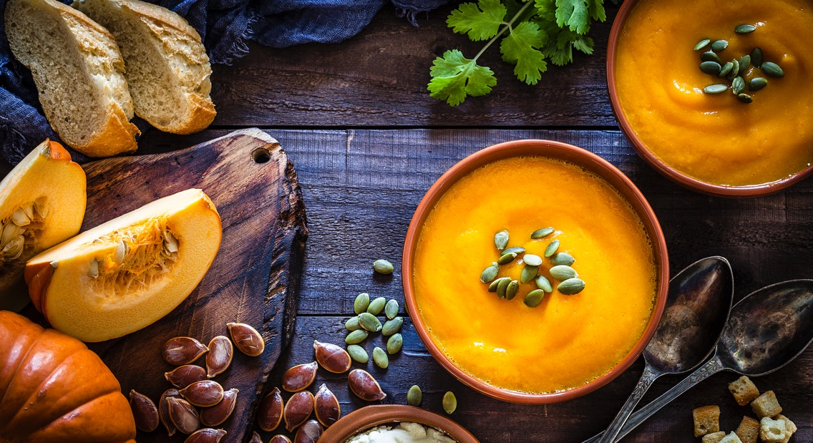
Module 2
Useful links for Food Service Businesses to reduce Food Waste across Europe
https://stopfoodwaste.ie/resource/top-tips-for-reducing-food-waste-in-food-service-businesses
Foodwaste | Food Waste Regulations | Food Waste Prevention : foodwaste.ie
https://foodwastecharter.ie/
https://www.cheaperwaste.co.uk/blog/food-waste-the-complete-2020-guide/
https://ec.europa.eu/newsroom/sante/items/691528
https://foodtank.com/news/2019/09/spains-first-food-sharing-app-is-tackling-food-waste/
https://www.nottingham.ac.uk/biosciences/documents/business/food-innovation-centre/food-waste-management-and-valorisation.pdf

Slide 19
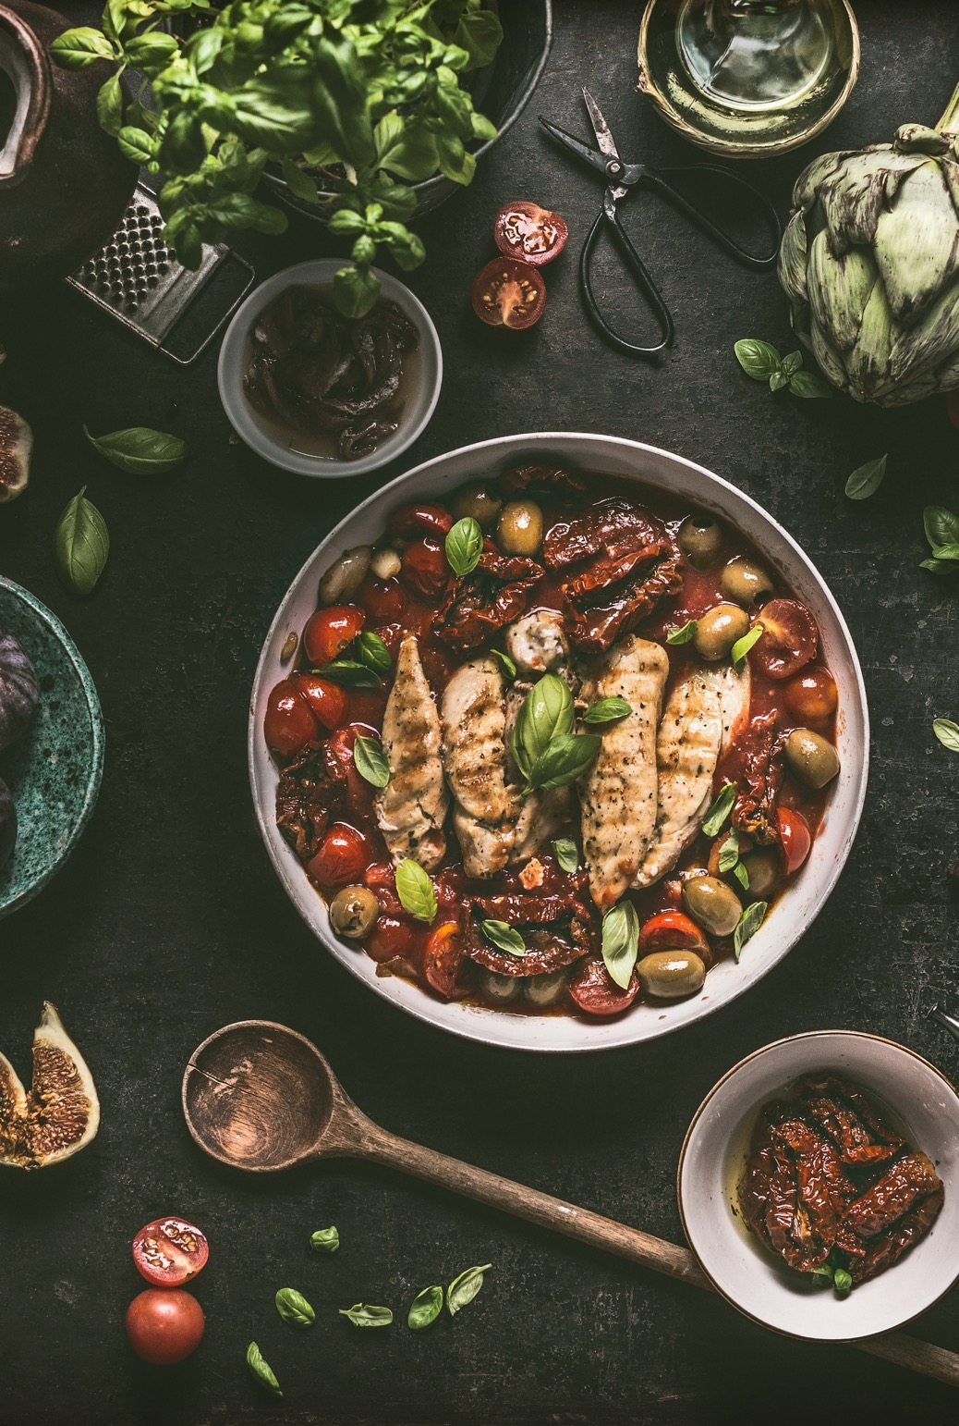
To truly understand taste and nutrition, you have to understand people – who they are, what they think and how they feel
- Kerry Health & Nutrition Institute

Slide 20
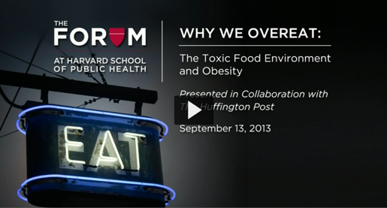
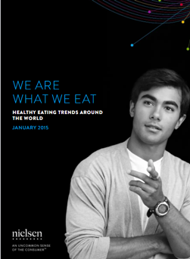
Module 3: Improving Natural Nutrition / Functional Foods
In this learning section, we will learn how to Innovate Food Service Businesses through Improving your Nutritional Offering and by introducing functional ingredients. We will focus of 5 topics;
The Links between FOOD – DIET – HEALTH
Nutraceuticals
Reducing Sugar & Salt
Natural Additives
Reducing Food Processing
LEARNING ACTION: Immerse yourself in these insightful reports!
The Forum at Harvard School of Public Health’s webcast “Why We Overeat: The Toxic Food Environment and Obesity.”
Nielsen Report – Consumer taking charge of their health

Slide 21
Module 3:
Slide 12
EXERCISE: HEALTH & WELLBEING
TOP TRENDS
How can you interpret these trends to innovate your food business ?
Pare back Ingredients, processes or packaging to emphasise the naturalness of your Product?
Leverage technology to help consumers make the most of your product & service, and to understand it’s health and energy benefits for adults and children alike!
Make your product customisable, and suitable for a variety of diets and lifestyles? How can it contribute to a holistically balanced lifestyle?
Can you see areas of change that may be possible in your Food Service Business?
Make notes on those options:
_________________________________________________________________________________________________________________________________________________________________________________________________________________________________________________________________________________________________________________________________________________________________________________________________________________________________________________________________________________________________________________________________________________________________________________

Slide 22
Module 3:
Slide 65
How can you as Food Service SMEs help?
By using less foods from Nova groups 3 & 4
By using less salt, sugar & fat when preparing food
By keeping informed & informing the customer
Sourcing good quality ingredients in their natural state
Notes:
_____________________________________________________________________________________________________________________________________________________________________________________________________________________________________________________________________________________________________________________________________________________________________________________________________________________________________________________________________________________________________________________________________________________________________________________________________________________________________________________________________________________________________________________________________________________________________________________________

Slide 23
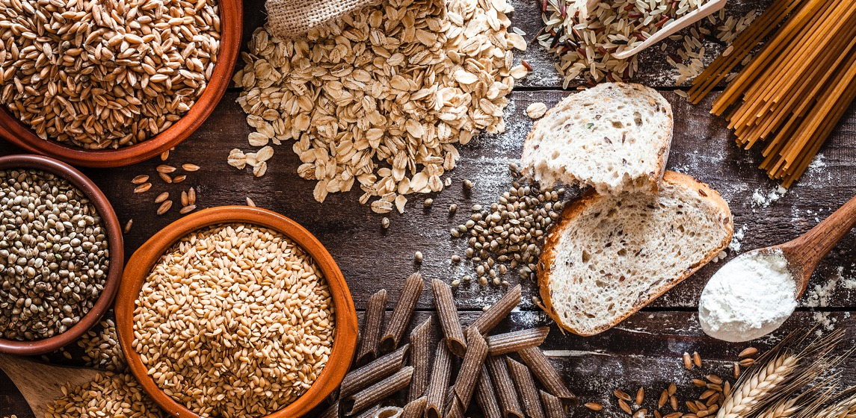
Module 3:
BE INSPIRED – Project Case Studies
Camile Thai:
An Irish company demonstrating how fast-food can also be Healthy Food and can be produced in a sustainable and ethical manner
Read the full story:
5.-Camile-Thai.pdf (foodinnovation.how)
Sweet Beat Cafe:
This is a prime example of a Food Service Business serving nutritious and delicious food both ready to eat options and those to take and serve at home.
Read the full story:
93-Sweet-Beat-Cafe.pdf (foodinnovation.how)
Kocbek: Pumpkin Seed Oil:
This case study demonstrates Good methods of food processing
Read the full story:
52-Kocbek.pdf (foodinnovation.how)

Slide 24
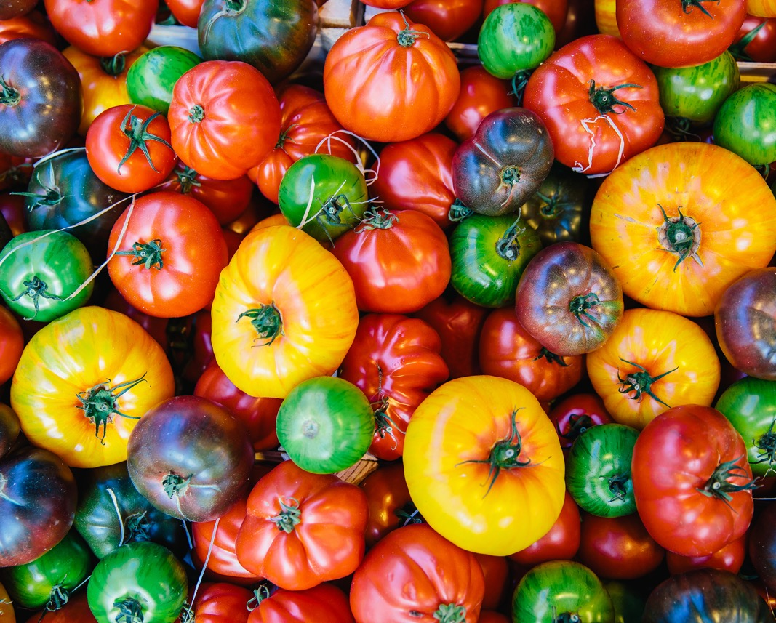
Short food supply chains have the potential for the food industry to act as a driver of change.

Slide 25
Module 4: Local & Short Supply Chains
In this module we will learn about the key types of supply chains and why short supply chains are so important in creating & maintaining a circular economy.
We will also discuss food waste & how the ‘Just-in-time’ helps in eliminating waste in the food service industry.
LEARNING ACTION: Immerse yourself in these insightful reports!
The Forum at Harvard School of Public Health’s webcast “Why We Overeat: The Toxic Food Environment and Obesity.”
Nielsen Report – Consumer taking charge of their health

Slide 26

Module 4:
Slide 29
EXERCISE: FOCUSING ON YOUR SUPPLY CHAINS
Can you list where you source the top five ingredients for your food service business?
Are you using short or long supply chains?
Is it possible for you to reduce your Supply chains?
Which new sourcing process is available to you, or would you be willing to use?
__________________________________________________________________________________________________________________________________________________________________________________________________________________________________________________________________________________________________________________________________________________________________________________________________________________________________________________________________________________________________________________________________________________________________________________________________________________________________________________________________________________________________________________________________________
_________________________________________________________________________________________________________________________________________________________

Slide 27
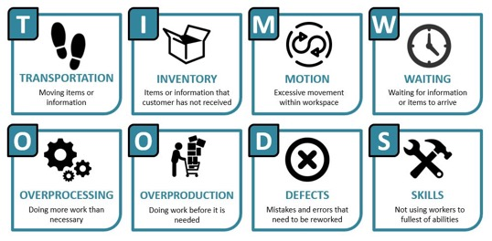
Module 4:
Slide 56
Using the acronym TIMWOODS to identify each type of waste.
Can you reflect on your business and see where you can reduce or eliminate waste for each letter of the acronym?
T
I
M
W
O
O
D
S

Slide 28
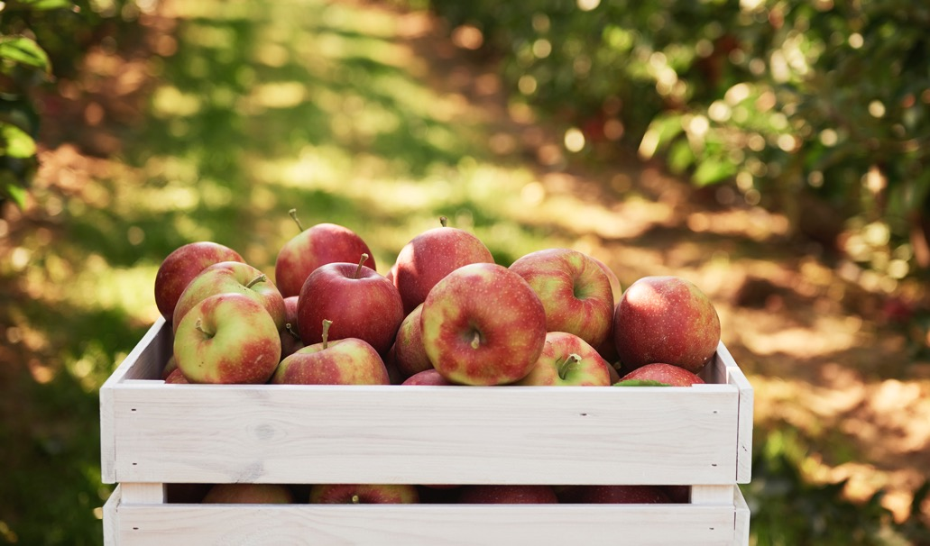
Module 4:
BE INSPIRED – Project Case Studies
Chef’s Farm:
A UK company demonstrating how transparency is key in supply chains and the responsibility chefs have for the future of food production
Read the full story:
Chef's Farms (chefsfarms.co.uk)
Mad Yolk Farm:
This is a prime example of a Food Service business starting from very little in an Urban setting and creating a short supply chain of free-range eggs to the area
Read the full story:
Our Story (madyolkfarm.ie)
Collectiv Food UK:
This case study demonstrates how to create a short supply chain in a sustainable way
Read the full story:
Sustainability (collectivfood.com)
Crussh:
This case study demonstrates how to create healthy menus using class 2 type fruit & veg and local suppliers with sustainability at the core of everything they do.
Read the full story:
About us – Crussh
Dobrina Ecological Box:
This case study demonstrates the use of a cooperative for the development of sustainable local supply while maintaining fair payment for growers & producers
Read the full story:
71-Ecological-Box.pdf (foodinnovation.how)
Baked in Brick
Adapting during Covid. Introduced fruit & veg boxes & provided food for the vulnerable.
Read the full story:
102-Baked-In-Brick.pdf (foodinnovation.how)

Slide 29
Module 4
Other RECOMMENDED reading & watching from the Module
https://evocco.hubspotpagebuilder.com/food-businesses a free guide from Evocco for food service businesses
FAQs for restaurants and hospitality (collectivfood.com)
North Tipperary Online Farmers Market - Open Food Network
OFN Ireland Launch! – YouTube Group formed to allow for collective direct sales
Leaf & Root and Loam, Galway – YouTube Showing how important the partnership between the chef/ food service business and the grower or supplier is.

Slide 30

The Food Service Sector plays an important role in shaping food sector trends as they act as intermediaries between producers and consumers.

Slide 31
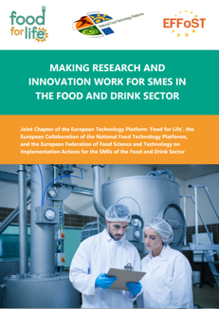
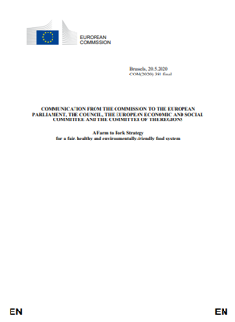
Module 5 : Food Technology for Food Service
In this module, we will learn about the advances in technology and communications and how they are changing the way we find, eat and dispose of our food. Since the start of the COVID-19 pandemic, the adoption of new technologies has been key for food sector businesses survival
LEARNING ACTION: Immerse yourself in these insightful reports!
Food and Drink Europe – Food for Life – Making Research & Innovation Work for SMEs
Farm to Fork Strategy

Slide 32
Module 5: Slide 6
EXERCISE: FOCUSING ON TECHNOLOGY SYSTEMS
Can you make a list of technology systems you are AWARE of in the Food Service Industry?
Then list any form of technology that is currently being USED in your Food Service Business.
______________________________________________________________________________________________________________________________________________________________________________________________________________________________________________________________________________________________________________________________________________________________________________________________________________________________________________________________________________________________________________________________________________________________________________________________________________________________________________________________________________________________________________________________________________________________________________________________________________________________________________________________________________________________________________________________________________________

Slide 33

Module 5: SLIDE 18
After learning about some of the options and benefits of contactless systems…
List 3 additional benefits of contactless systems for the Food Service Industry
REFLECTION EXERCISE
1
2
3

Slide 34
Module 5: Slide 56
EXERCISE: FOCUSING on SOCIAL MEDIA
You are aware that the importance of Social in the Food Industry is increasing:
PLEASE REFLECT
How many platforms your business has a presence on?
How frequently you post?
Could you interact more frequently?
Are you tracking the activity of your accounts and where can you improve?
______________________________________________________________________________________________________________________________________________________________________________________________________________________________________________________________________________________________________________________________________________________________________________________________________________________________________________________________________________________________________________________________________________________________________________________________________________________________________________________________________________________________________________________________________________________________________________________________________________________________________________________________________________________________________________________________________________________

Slide 35

Module 5:
BE INSPIRED – Project Case Studies
Elika Jan Project:
A Spanish company demonstrating how the use of technology is improving the storage and shelf life of products
Read the full story:
101-Elika-Jan-Project.pdf (foodinnovation.how)
Fit Panther:
This is a prime example of a Food Service business delivering high-quality food made from selected and organic products and deliver it ready for consumption to the home/office within the city of Sofia
Read the full story:
37-Fit-Panther.pdf (foodinnovation.how)
The Dough Bros:
This case study demonstrates how a small pizza business pivoted during the pandemic and started producing Meal-kit Boxes as an alternative revenue stream
Read the full story:
Home (thedoughbros.ie)
Camile Thai:
An Irish company demonstrating how useful technology and an App can be for providing your customers with information and for gaining data on them via the App
Read the full story:
5.-Camile-Thai.pdf (foodinnovation.how)
Salateria Soups & Salads:
This case study demonstrates the use of technology for informing and educating their customers in regard to their offerings and general health & nutrition. This company also uses a delivery platform
Read the full story:
35-Salateria-Soup-and-Salads.pdf (foodinnovation.how)

Slide 36

“Whether you look at it from a human health, environmental or climate perspective, our food system is currently unsustainable and given the challenges that will come from a rising global population that is a really [serious] thing to say “
– Tim Benton, University of Leeds

Slide 37
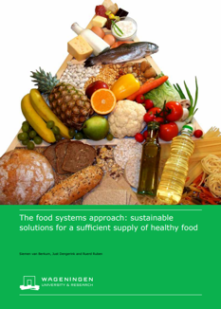

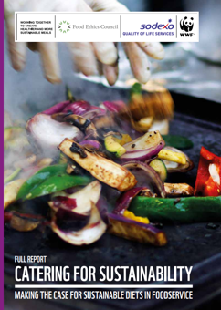
Module 6 : Transformational Impact of Food Technology and Sourcing
In this module, we will learn how technology is changing the food we eat and how food service businesses can make better sourcing decisions for the health of their customers, and the health of the planet. We cover:
The Science of Food
Technology in Production
Technology in Processing
Engaging with Suppliers
LEARNING ACTION: Immerse yourself in these insightful reports!
180630_foodsystems-approach.pdf (knowledge4food.net)
From-Farm-to-Fork.pdf (enterprise-ireland.com)
wwf_catering_full_report.pdf

Slide 38
Module 6:
Slide 10
EXERCISE: FOCUSING on Food Science & Technology
Food Science consists of the use of several scientific disciplines to improve efficiencies in the food system.
How many of these disciplines listed on Slide 10 are you familiar with?
Science Discipline | Food
Cell Biology | Understanding of postharvest plant physiology, food quality, plant disease control, and microbial physiology; food safety
Biotechnology | Creating crops with better vitamin content; enzymes for cheesemaking, breadmaking, and fruit juice manufacture
Chemistry | Essential for implementing many of the tech applications listed; extended shelf life; Food Analysis
Computer Science | Data Analysis, process control
Genomics | Understanding of plant and animal characteristics; improved control of desirable attributes; rapid detection and identification of pathogens
Materials Science | Effective Packaging; understanding of how the material properties of food contribute to texture and taste
Microbiology | Understnading the functions of bacteria (beneficial, spoilage, and disease-causing), parasites, fungi, and viruses, and improvements in their detection
Nutrition | Fortified foods with vitamins and minerals as well as developing diets that suit individuals needs
Sensory Science | Understanding of chemo-senses (taste and odour) to meet different flavour needs and preferences
Toxicology | Assessment of the safety of chemical and microbiological food components, food additives
Physics/Engineering | Efficient food manufacturing processes that improve food attributes and ensure food safety; pollution control; environmental protection, waste reduction efforts
______________________________________________________________________________________________________________________________________________________________________________________________________________________________________________________________________________________________________________________________________________________________________________________________________________________________________________________________________________________________________________________________________________________________________________________________________________________________________________________________________________________________________________________________________________________________________________________________________________________________________________________________________________________________________________________________________________________

Slide 39

Module 6: SLIDE 22
After watching Virtual Water - YouTube do you think more about the global implications of our food choices??
Task:
Research how much water is used to produce the main products you offer!
REFLECTION EXERCISE
This Photo by Unknown Author is licensed under CC BY-NC

Slide 40
Module 6: Slide 32
What can food service businesses do to contribute towards sustainable farming?
e.g. it is important to engage with suppliers and to stay up to date with food trends. Expand……..
How much do you know about the sustainability of your produce?
A great way to start is by checking the country of origin and exploring environmental issues facing them.
Your approaches/thoughts/actions
_____________________________________________________________________________________________________________________________________________________________________________________________________________________________________________________________________________________________________________________________________________________________________________________________________________________________________________________________________________________________________________________________________________________________________________________________________________________________________________________________________________________________________________________________________________________________________________________________

Slide 41
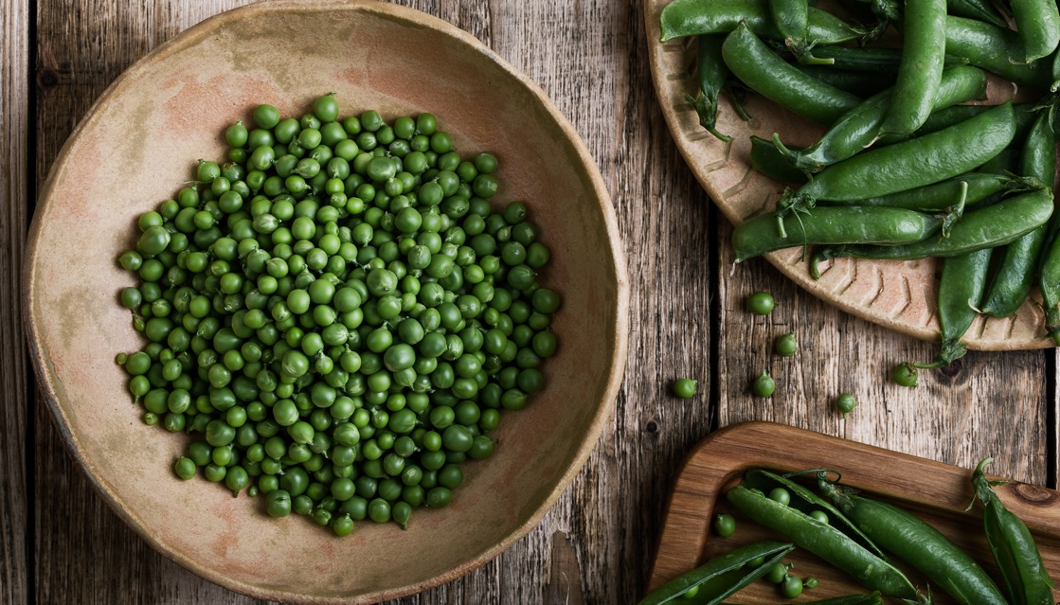
Slide 51
Reflection: Factor to Consider
The message is loud and clear. We must eat less meat to save the planet and protect our health.
Are plant-based meat substitutes able to deliver enough protein to sustain us?
Your Thoughts…
As food service operators:
Are you providing nutritious balanced meals?
Some meat substitute products are highly processed foods…can you make your own to avoid this?
________________________________________________________________________________________________________________________________________________________________________________________________________________________________________________________________________________________________________________________________________________________________________________________________________________________________________________________________________________________________________________________________________________________________________________ _

Slide 42
Module 6:
Slide 58
In this section, we have explored some of the opportunities available through food processing by implementing food science and technology to add value to natural resources.
What sustainably preserved options can enhance your food service business ?
2. Have you experimented with any meat, dairy or egg alternatives?
1.
2.
_____________________________________________________________________________________________________________________________________________________________________________________________________________________________________________________________________________________________________________________________________________________________________________________________________________________________________________________________________________________________________________________________________________________________________________________________________________________________________________________________________________________________________________________________________________________________________________________________

Slide 43

Module 6:
BE INSPIRED – Project Case Studies
Farm Eye - Ireland:
This technology company is one company that is revolutionizing farm production through technology
Read the full story:
Farmeye | Soil health for a sustainable future | Soil to Supermarket
Neantog:
An Irish organic enterprise that is a preserving champion
Read the full story:
61-NEANTOG.pdf (foodinnovation.how)
Km.0 Vegan Vegetarian Restaurant:
This case study demonstrates how a Plant based restaurant can successfully serve meat substitutes in a sustainable way
Read the full story:
92-KM0.pdf (foodinnovation.how)
Inoveat Restaurant:
This is one of the first restaurants in Europe to trial serving insects as an alternative source of protein
Read the full story:
Inoveat | Restaurant
About Coffee:
Coffee is such an integral part of everyday life that few of us stop to think what goes into growing the beans that make this hugely popular beverage
Read the full story:
About Coffee - Fairtrade Foundation
Blue Lobster App:
This App enables shortened supply chains and increased transparency for restaurants stocking fish.
Read the full story:
Blue Lobster | The first app based marketplace for low-impact seafood
Elika Jan Project:
A Spanish company demonstrating how the use of technology specifically QR codes is improving the acquisition, storage and shelf life of products
Read the full story:
101-Elika-Jan-Project.pdf (foodinnovation.how)

Slide 44

Module 6:
Other RECOMMENDED reading & watching from the Module
IPCC — Intergovernmental Panel on Climate Change
Inside the Book: Amanda Little (THE FATE OF FOOD) – YouTube
Obesity and overweight (who.int)
The Dangers of Pesticides | Green Science | Learn Science at Scitable (nature.com)
kiss the ground – YouTube The trailer for Kiss the Ground. Watch it and discover a simple solution for climate change. The full-length film is now streaming on Netflix!
The future of Food and Farming - final report (publishing.service.gov.uk) Challenges & choices for Global sustainability
Feeding Cattle a Bit of Seaweed Reduces Their Greenhouse Gas Emissions 82% (scitechdaily.com)
Vertical farming sector struggles with costs - Future Farming - the issue with vertical farming
bring meatless meat to new locations
Consumers seek more significant and meaningful sustainability benefits from F&B products, flags Kerry (foodingredientsfirst.com)
Are plant-based meat substitutes actually good for us? (irishexaminer.com)
How Technology Is Transforming The Food Industry (forbes.com)

Slide 45

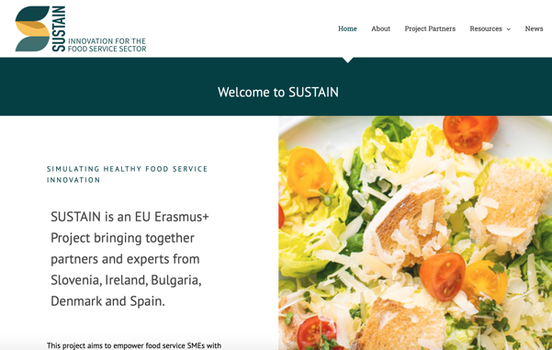
Congratulations
You have completed the SUSTAIN Course!
Follow our journey here

