Slide 1
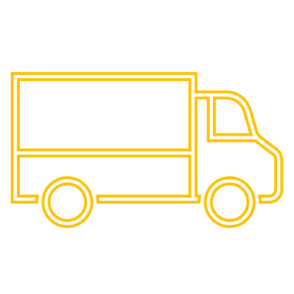
A quick exercise…
Long Supply Chain
Short Supply Chain
In your workbook:
Can you list where you source the top five ingredients for your food service business?
Are you using short or long supply chains?
Is it possible for you to reduce your Supply chains?
Which new sourcing process is available to you, or would you be willing to use?

